Slide 1

Creating an Impact School
jim knight, Instructional Coaching group
JimKnight@mac.com

Slide 2

Our Question
How do we create schools in which every student receives excellent instruction, in every class, every day?

Slide 3
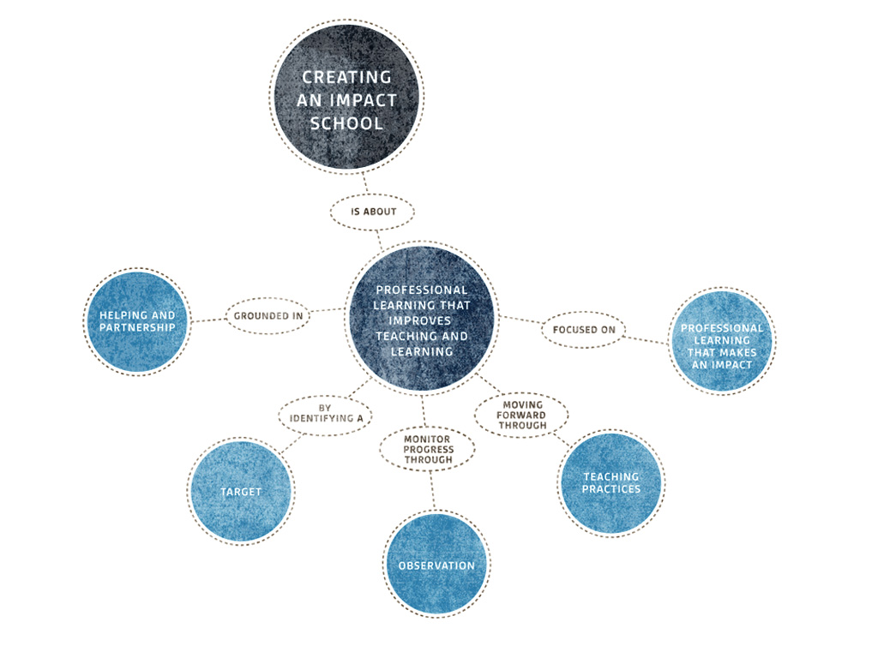

Slide 4
My first
teaching experience

Slide 5

1.

Slide 6

Humanity

Slide 7


There is a simpler way to organize human endeavor. It requires being in the world without fear. Being in the world with play and creativity. Seeking after what’s possible. Being willing to learn and be surprised. (Margaret Wheatley)

Slide 8
Helping
CHANGE
IDENTITY
THINKING
STATUS
MOTIVATION

Slide 9
Partnership
Equality
Choice
Voice
Dialogue
Reflection
Praxis
Reciprocity

Slide 10
Design
Notes:
Traditional Training
advance organizer
overheads
summary statements every 20 minutes
every 10 minutes paused to ask questions
extensive elaboration of content on each overhead
Partnership Learning (timed to be equal; same outline)
Experiential Learning
attending to images or questions while I read
Question Recipes
used to debrief almost all learning structures
Tell me more about that ... How do you see this working
Reflection Learning modeling
Thinking Devices modeling & feedback
Stories M. Hunter; teaching experiences
Cooperative Learning TTYN; scoring

Slide 11
Research Questions
Knowledge
Implementation
Engagement
Enjoyment
Notes:
Knowledge: will they know more at the end of a session
Implementation: expectation vs. authentic implementation
Engagement: more engaged = more knowledgable
Enjoy: more positive attitude toward the content

Slide 12
Measures
Knowledge Test
Implementation Question
Engagement Form
Workshop Evaluation
Notes:
knowledge test: p. 102
implementation question: “Now that you have learned about two strategies, which of the two do you believe you are most likely to implement?”
engagement form: p.121
workshop evaluation p.122

Slide 13
Engagement Form
Notes:
chi square: 46.90 [6 df ] [p = 0.00]
engaging
Partnership Learning: 89.3%
Traditional Training: 40.1%
not engaging
Partnership Learning: 2.6% (2 people out of 74%)
Traditional Training: 37.4

Slide 14
Implementation Question**
    Partnership Learning: 59
    Traditional Training: 14
**Now that you have learned about two strategies, which of the two do you believe you are most likely to teach?

Slide 15
Do you think teachers should be partners in their own learning?

Slide 16
2.

Slide 17
Why do you need an instructional target?

Slide 18
Three critical elements
Understanding
Agreement
Commitment

Slide 19
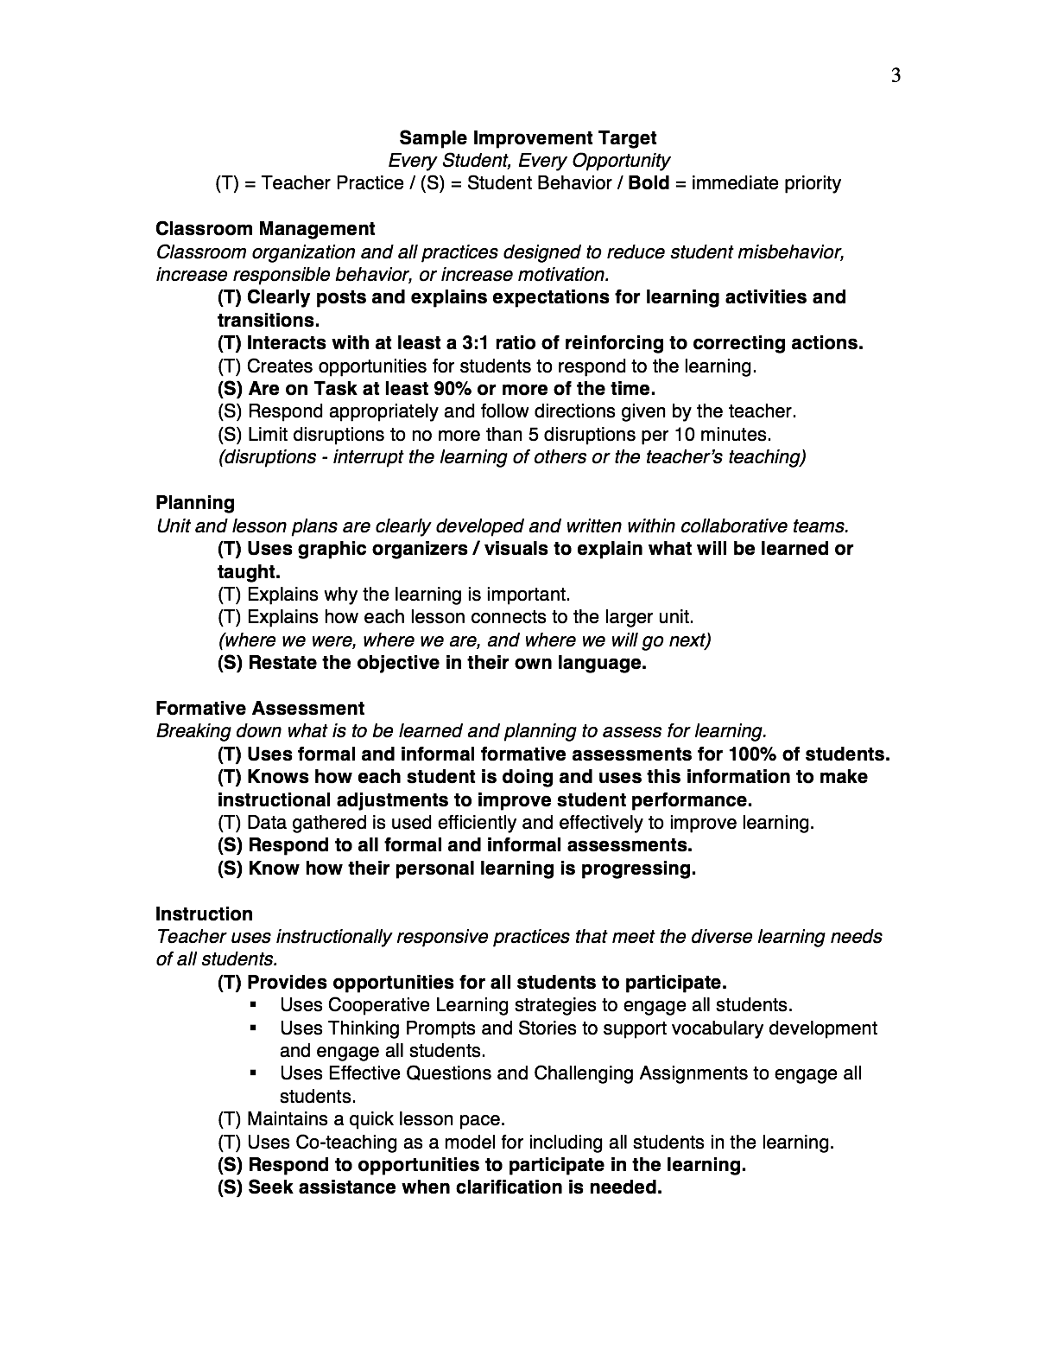

Slide 20
Transitions are 5% or less

Slide 21
An Excellent Target
One page
As simple as possible, but no simpler
Precise
Observable
Teacher & Student
Doable

Slide 22
Target design team

Slide 23
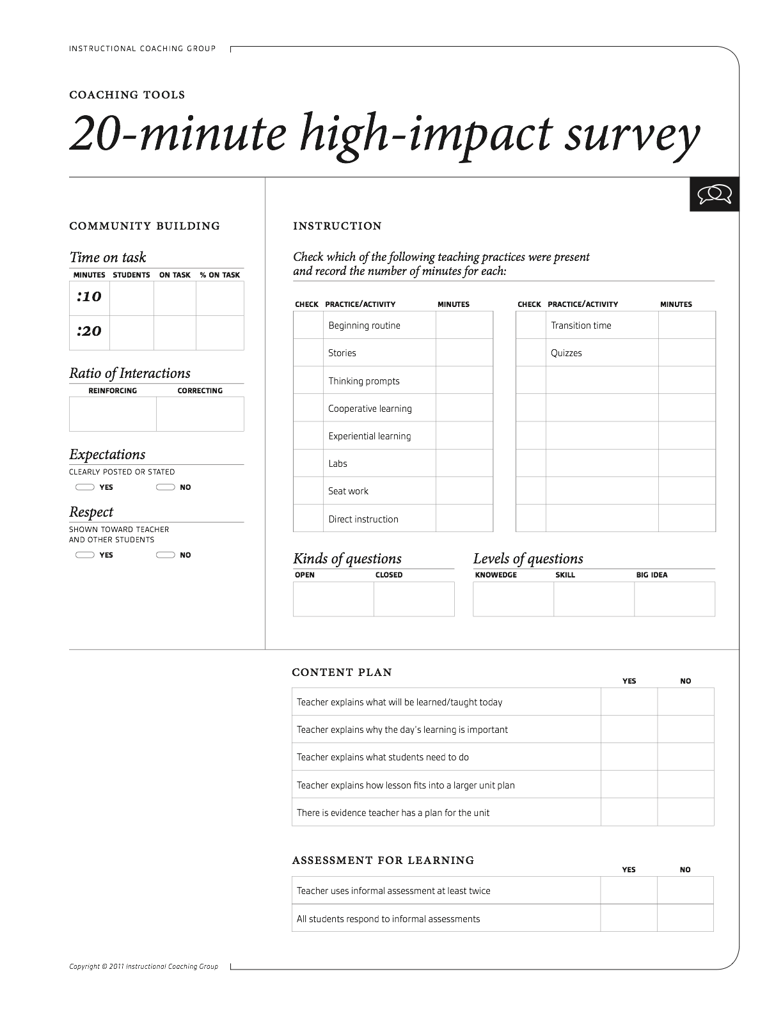

Slide 24
Teacher meetings

Slide 25
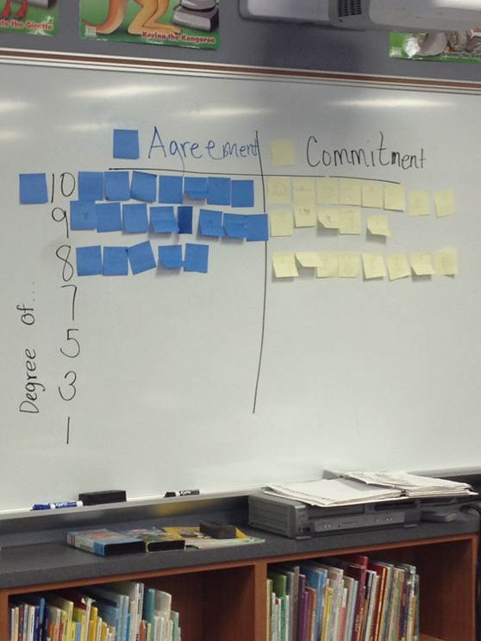

Slide 26
Creating the Target
One-page target
Target design team
Teacher meetings
Teacher commitment
Central office support

Slide 27
Central office support

Slide 28
How will you get understanding, agreement, and commitment?

Slide 29
3.

Slide 30
Observing teachers, monitoring progress

Slide 32
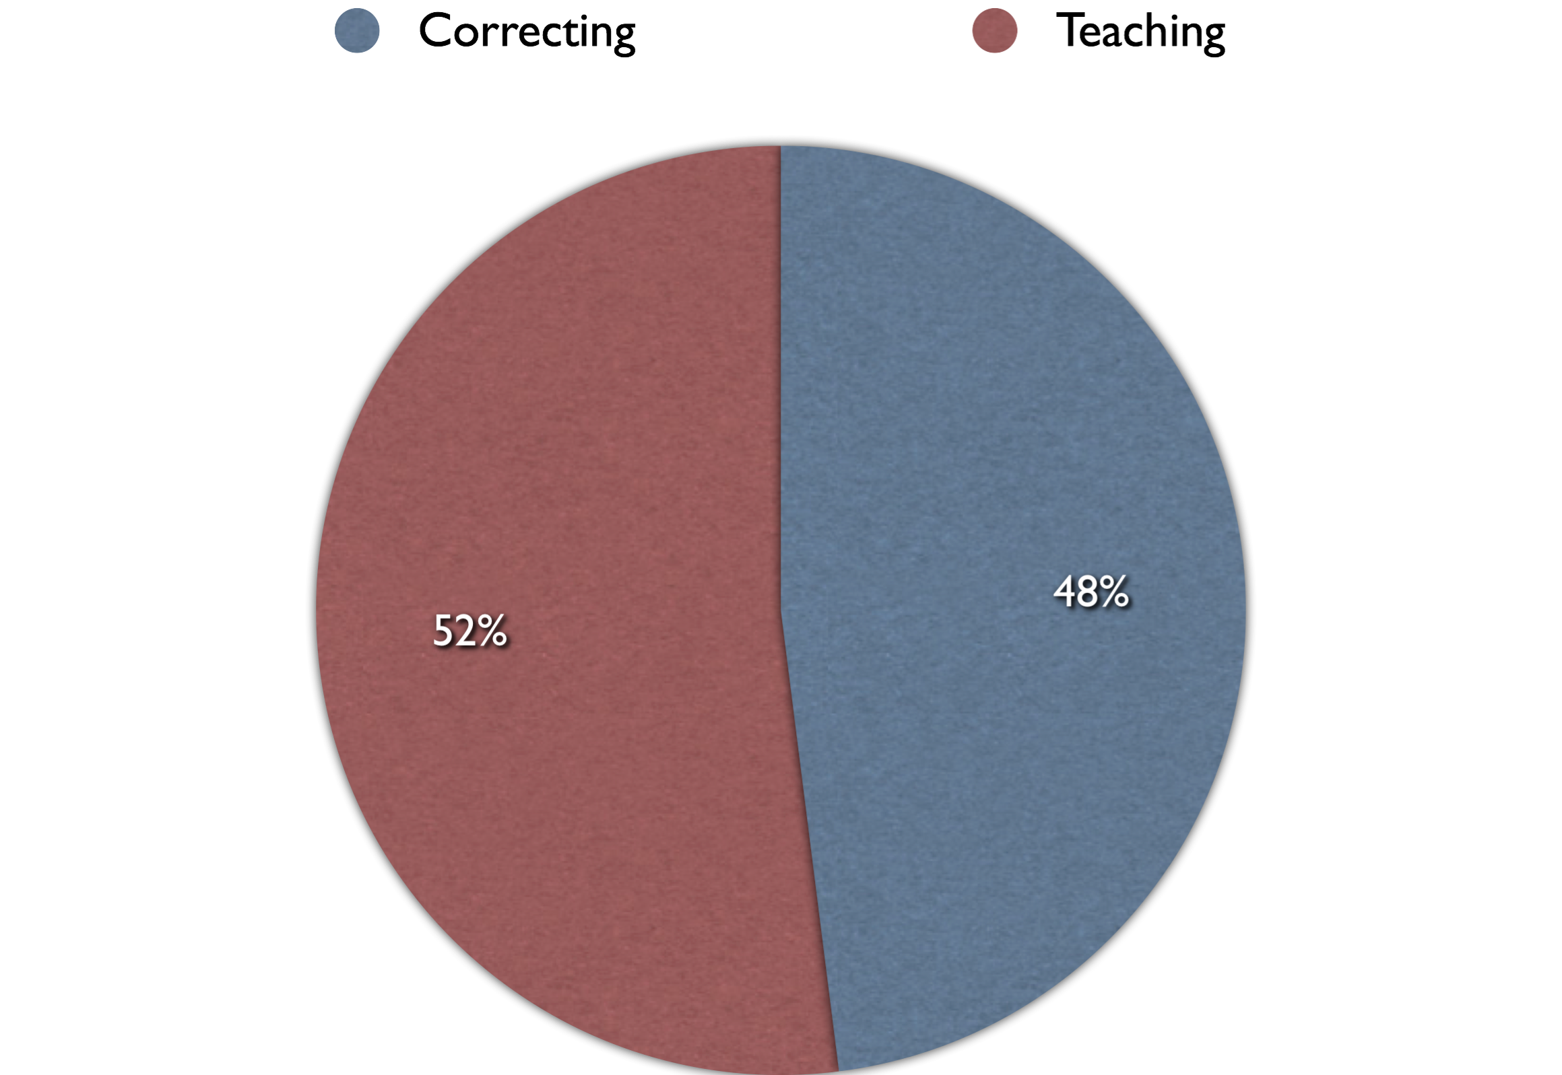

Slide 33
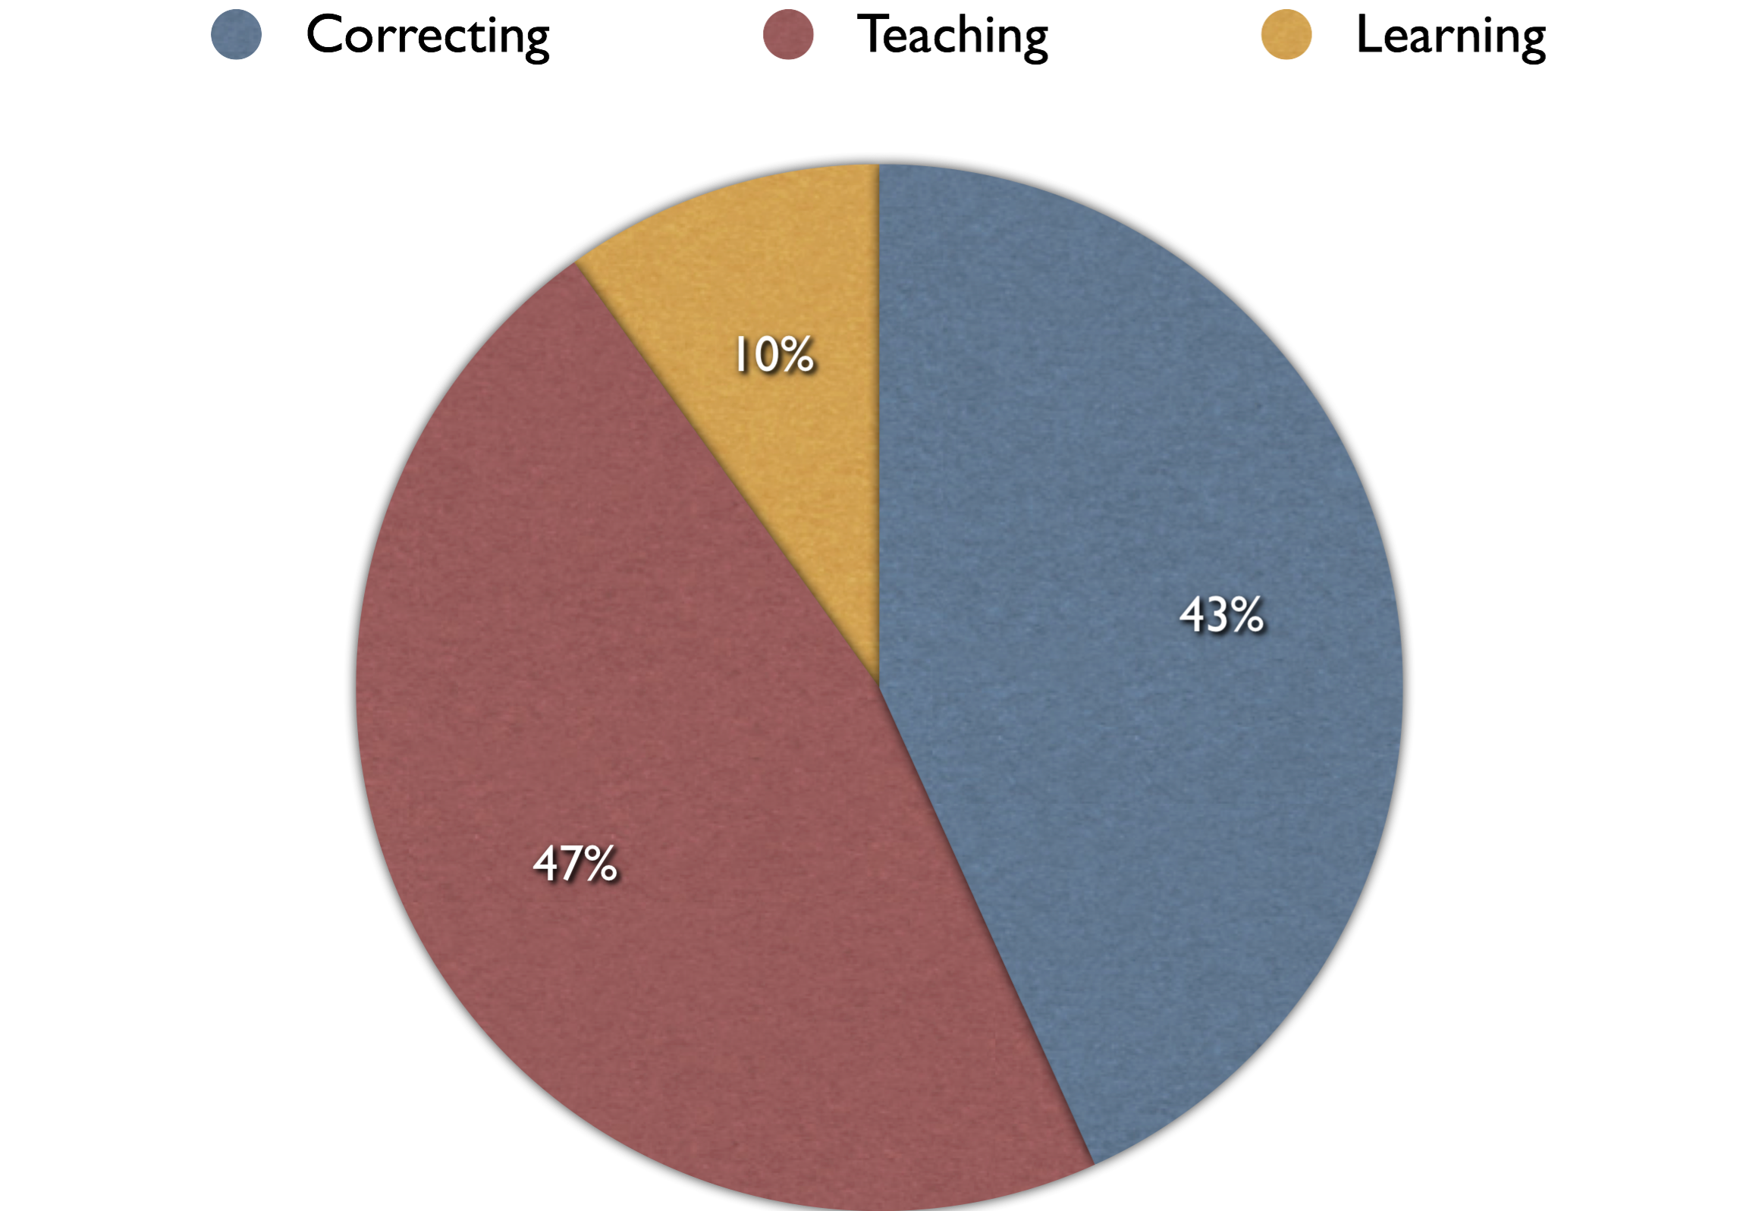

Slide 34
.52 x .20 = .10

Slide 35

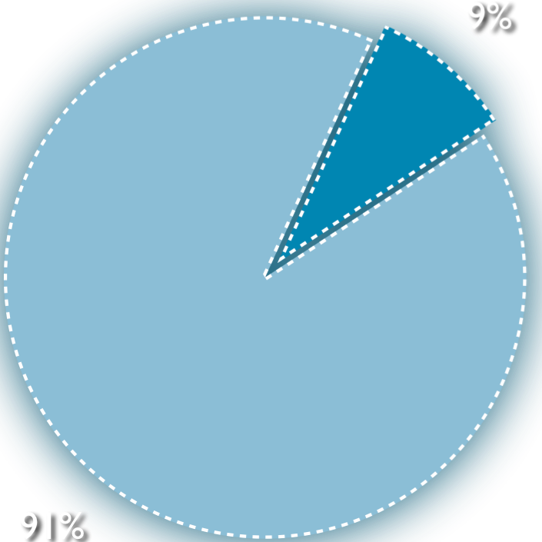
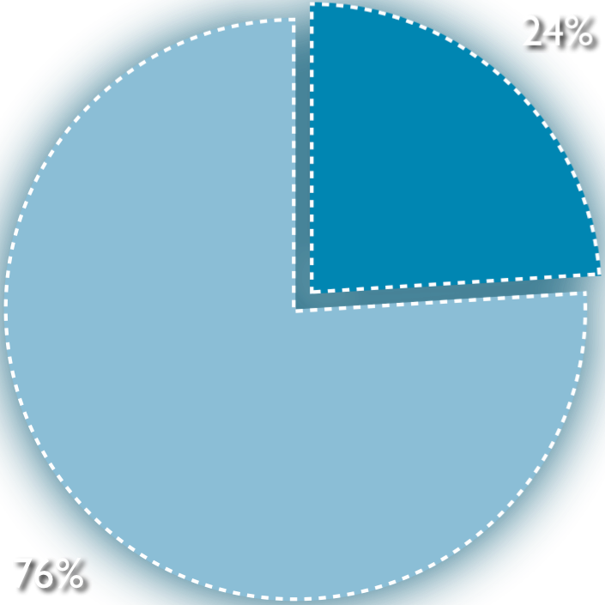
Time on Task (10 min)
FEBRUARY 2011
OCTOBER 2012
STUDENTS | ON TASK | % ON TASK
738 | 559 | 76%
STUDENTS | ON TASK | % ON TASK
818 | 742 | 91%

Slide 36
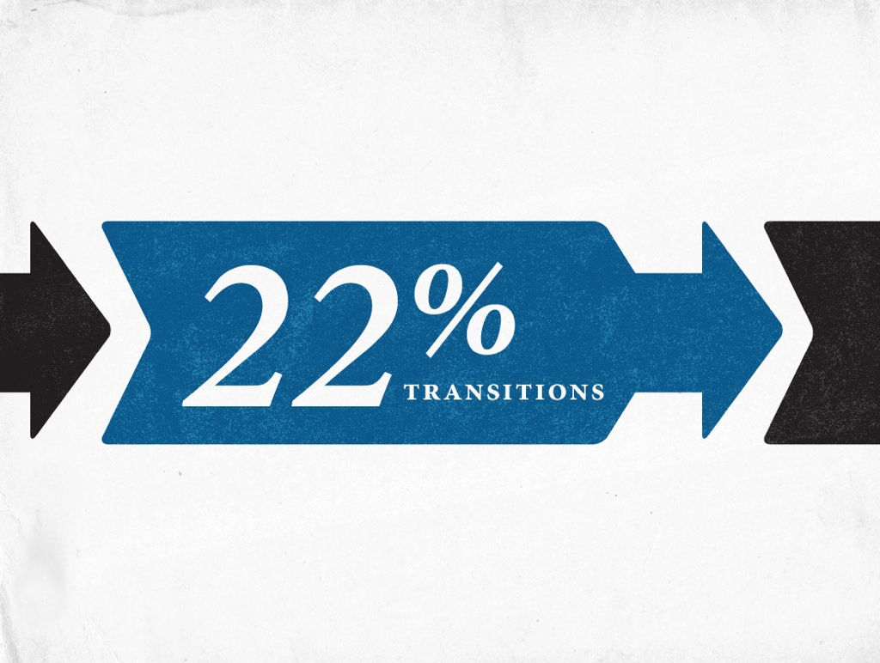

Slide 37

20 months later...

Slide 38
February 2011
.76 x .78 = .59

Slide 39
October 2012
.91 x .96 = .87

Slide 40
4.

Slide 41
http://www.corwin.com/highimpactinstruction

Slide 42
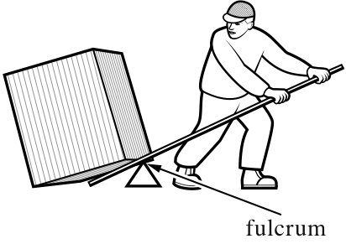

Slide 43
The Big Four
4
Content Planning
Assessment for Learning
Instruction
Community Building

Slide 44

Effective
Questions

Slide 45
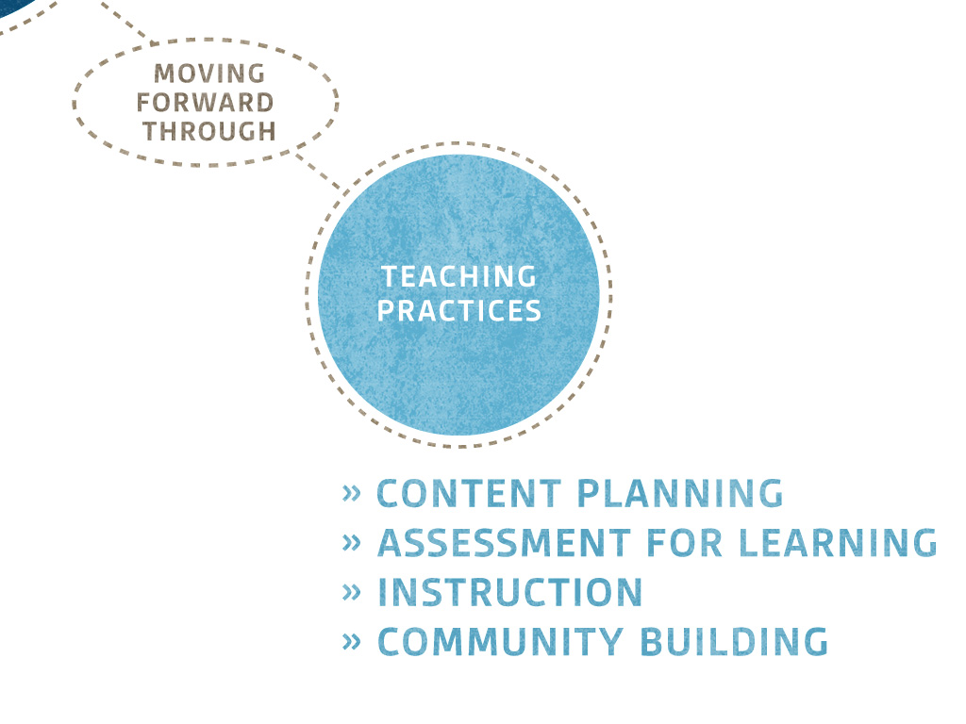

Slide 46
5.

Slide 47
Components
Enroll
Identify
Explain & Mediate
Model
Observe
Explore
Support & Refine
Notes:
My two examples, coffee and running

Slide 48
Top-down Coaching
COACH
uses data to shape
TEACHER

Slide 49
Partnership Coaching
DATA
dialogue
TEACHER
COACH

Slide 50
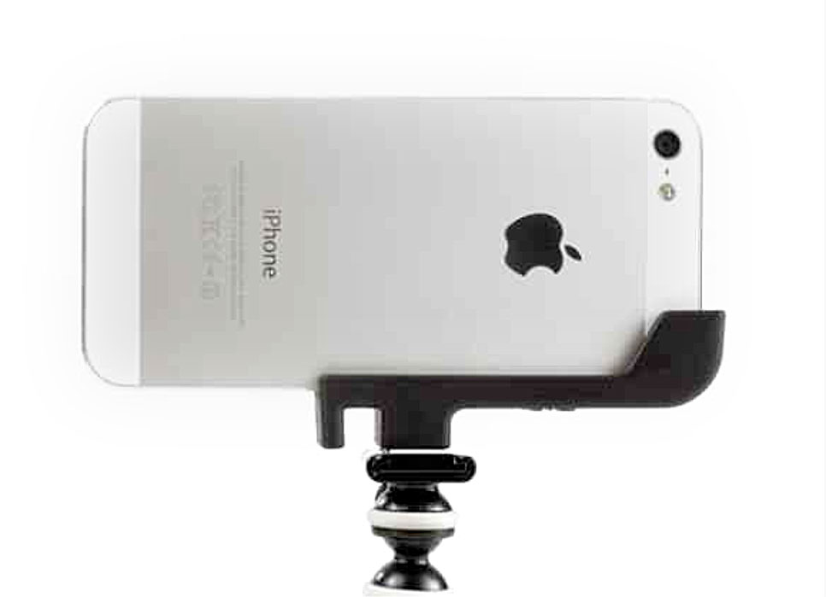

Slide 51
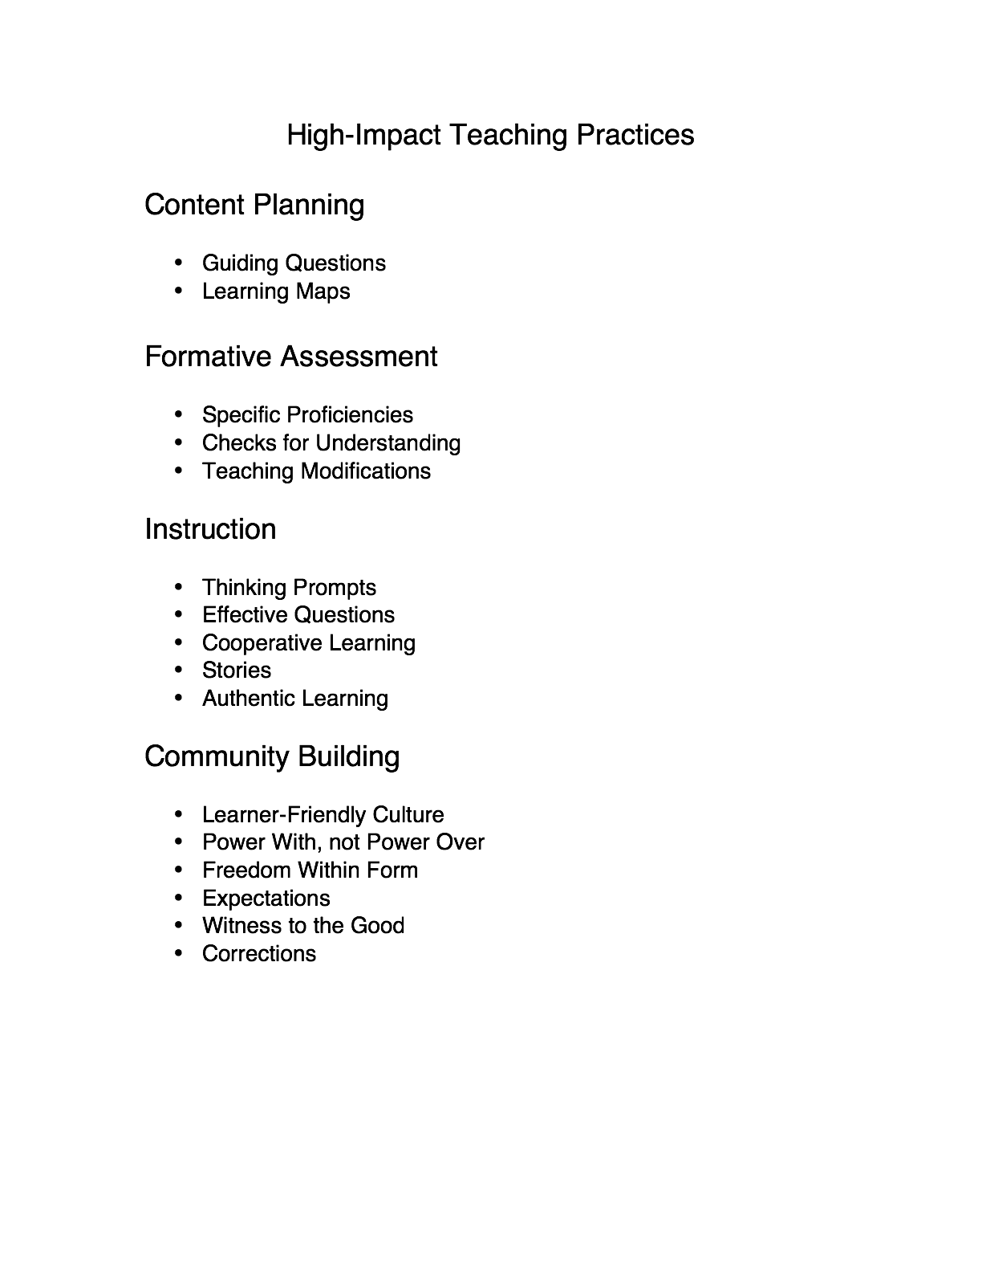
51

Slide 52
Components
Enroll
Identify
Explain & Mediate
Model
Observe
Explore
Support & Refine
Notes:
My two examples, coffee and running

Slide 53
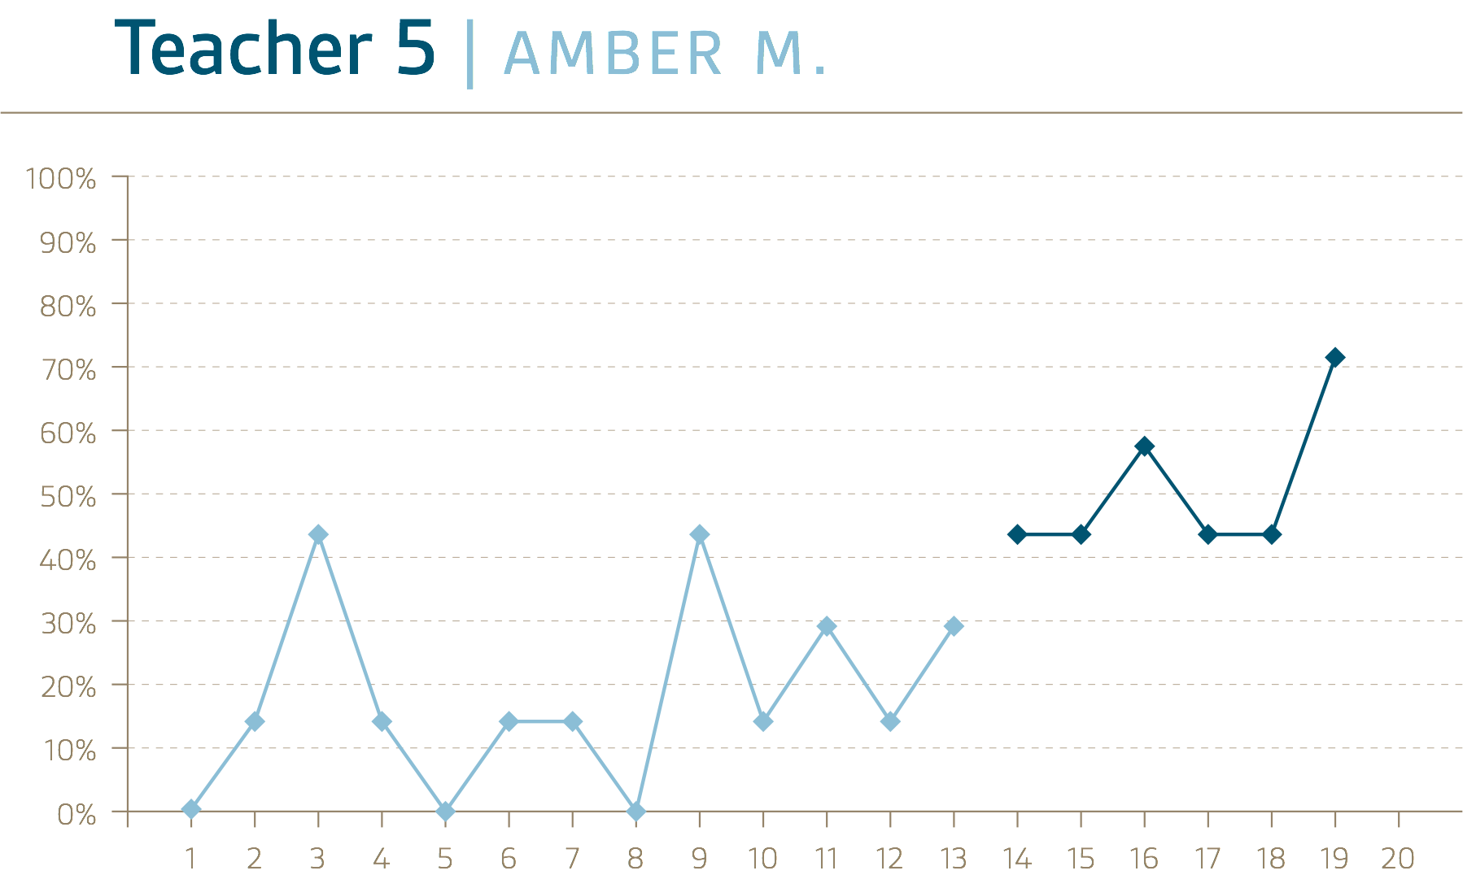

Slide 54
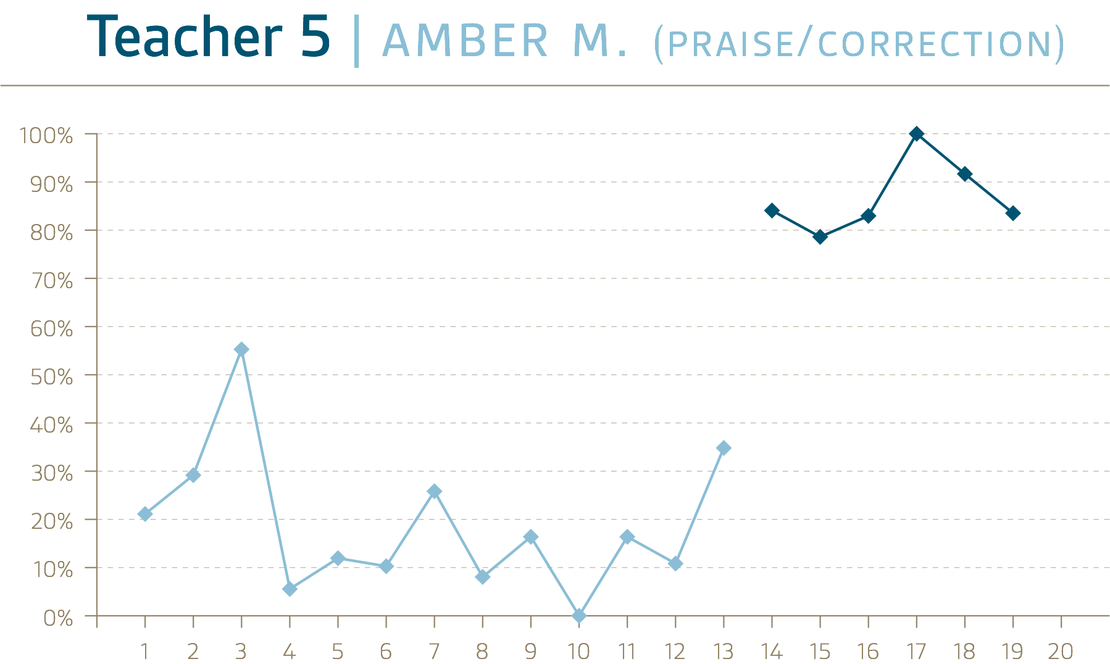

Slide 55
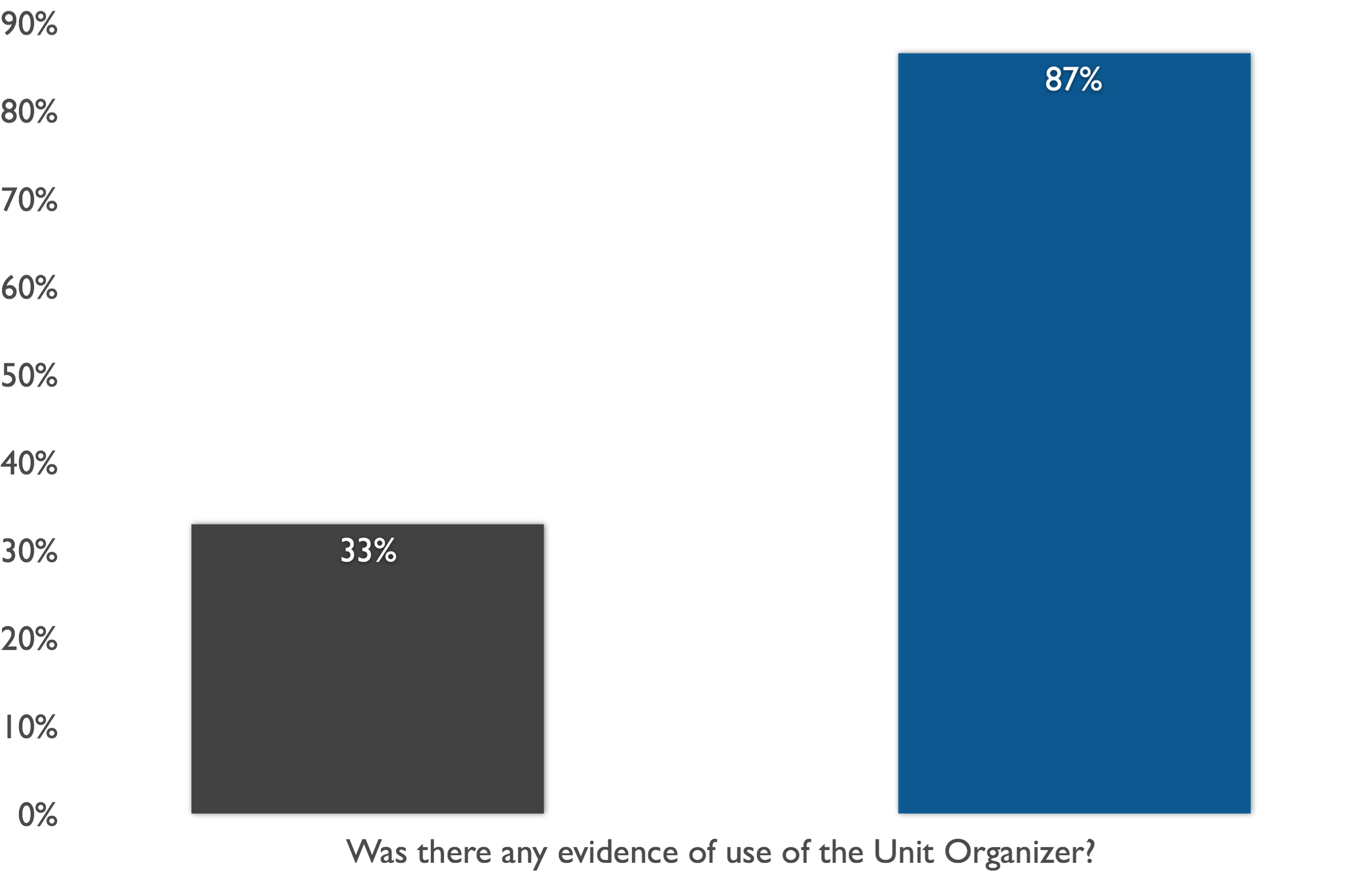
Notes:
Content Enhancement Routine: The Unit Organizer
These are mean scores.
See Table in the back of your packet for the statistics.
STATISTICALLY SIGNIFICANT

Slide 56
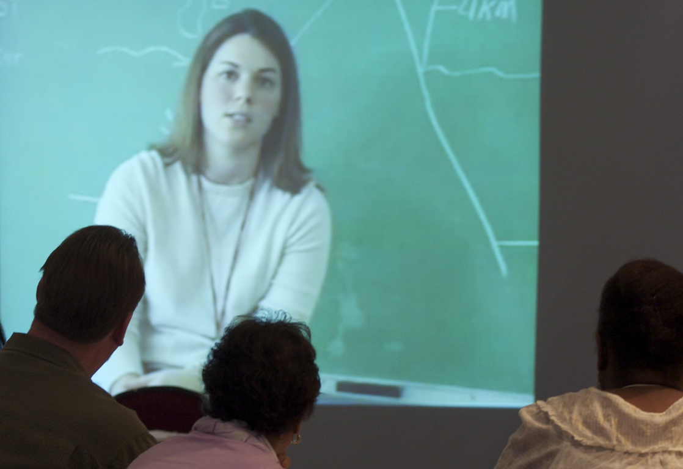
Workshops & Presentations
Notes:
• Use the Big Four practices
• Use the partnership principles -
When a person says one thing and does something else it’s not effective
Giving a lecture on cooperative learning wouldn’t make it very effective.
Is there anythingelse we can do to walk the talk in our presentation

Slide 57

Intensive Learning Teams

Slide 58

Principal

Slide 59
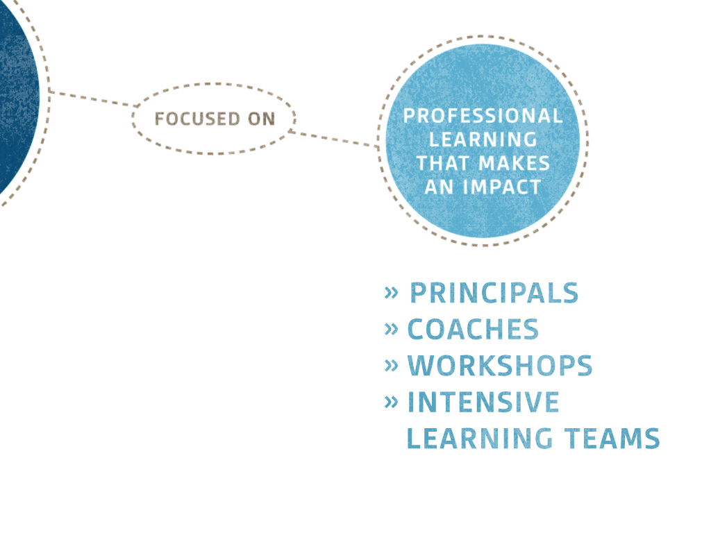

Slide 60
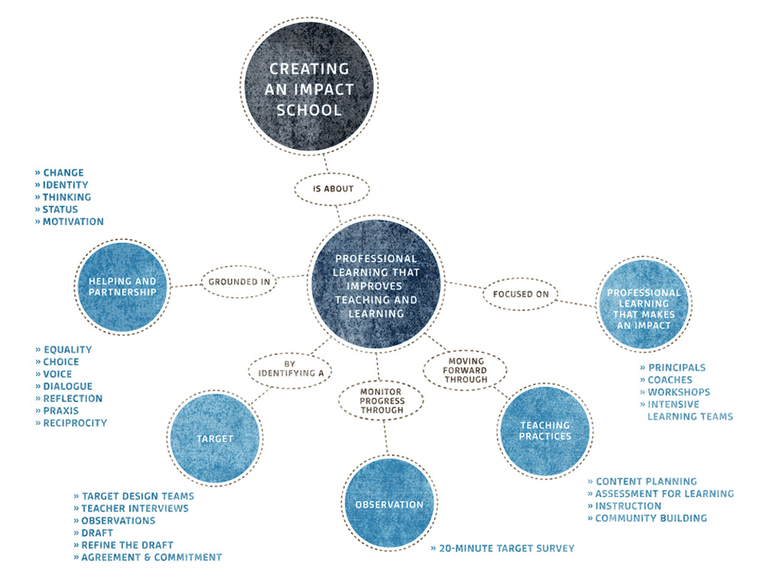

Slide 61
jimknight@mac.com

Slide 62
http://www.radicallearners.com

Slide 63
https://www.facebook.com/instructional.coaching

Slide 64
http://www.instructionalcoaching.com

Slide 65
@jimknight99

