Slide 1







Common Core State Standards
Unleashing a Wave of
NEW INNOVATION

Slide 2




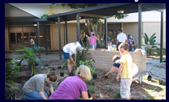


Reaching the
Core of Common Core
Lee County Public Schools

Slide 3
Presenters
Patti Elkin, Director: Curriculum & Staff Development
  PattiDE@leeschools.net
Lori Houchin, Coordinator for Secondary Reading
- Lorimh@leeschools.net

Slide 4

Lee County Common Core Website
Notes:
Patti – website
The need for it, the sharing across district
Talk about development.

Slide 5
District Timeline
SY 11-12
Summer 2012
SY 12-13
Summer 2013+
Kindergarten Implementation
Building the Foundation Training for all Teachers
Kindergarten, Grade 1, 6-12 Content Literacy Implementation
Sustainability
Notes:
Summer 2012:
SY 12-13:
Summer 2013:
SY 13-14:

Slide 6
LCSD CCSS Implementation: Phase 1
Summer 2012 – May 2013
Instruction
Assessment
Curriculum
Academic Plans
District and Classroom Assessments
Instructional Materials Adoption
Professional Development
Notes:
The normal process is usually curriculum, instruction, and assessment. However, in the LCSD instruction is the heart of the matter. Curriculum are the resources used in the classroom, whereas instruction is viewed as the teaching and learning of the standards. Therefore, even with the Instructional Materials Adoption cycle falling a few years within the FLDOE CCSS Implementation schedule we have been able to move ahead with a strong CCSS Implementation plan. In sharing our implementation plan with you, we’ll guide you through the areas of instruction, assessment and curriculum. We’ll talk about what we have done in each of these main areas.

Slide 7
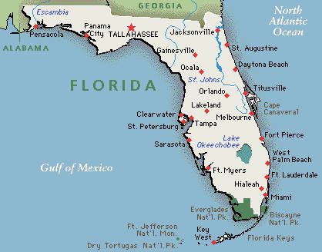

Academic Plans:
Our Instructional Road Map
When upgrading classroom instruction to the CCSS, the first place to begin was to UPGRADE our Academic Plans.
Notes:
The Lee County Academic Plan System was established to serve our students, teachers, and parents. Our Academic Plans provide information and instructional objectives, vocabulary, and instructional resources for over 100 courses offered by the district. They were written by outstanding teachers and curriculum coordinators within the District and are updated annually to ensure that all students receive the quality instruction needed to reach their greatest potential.

Slide 8
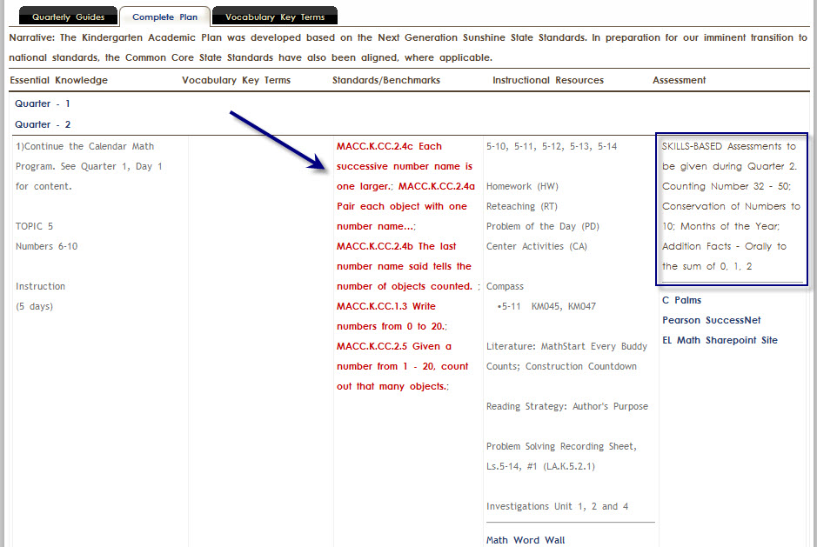
Kindergarten: Academic Plan
Our previous template was “aligned” to the Common Core Standards but that was not enough.

Slide 9
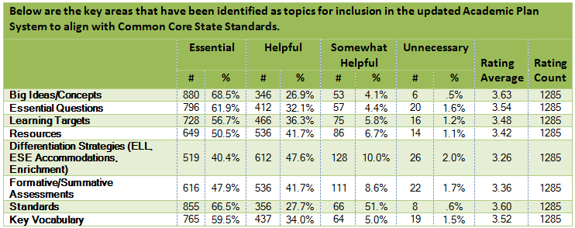
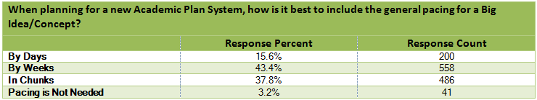
Teacher and Administrator Survey
Are there other key components that should be considered for inclusion in the updated Academic Plan System?

Slide 10
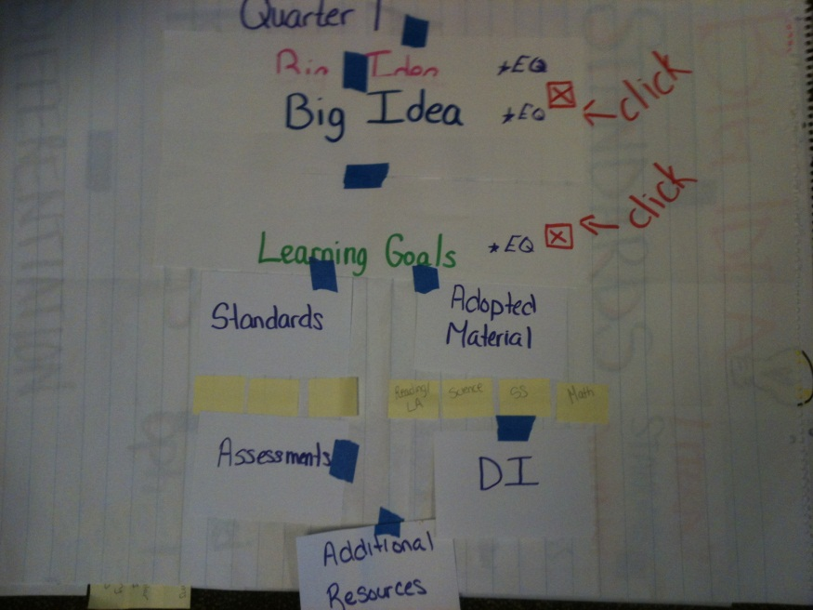
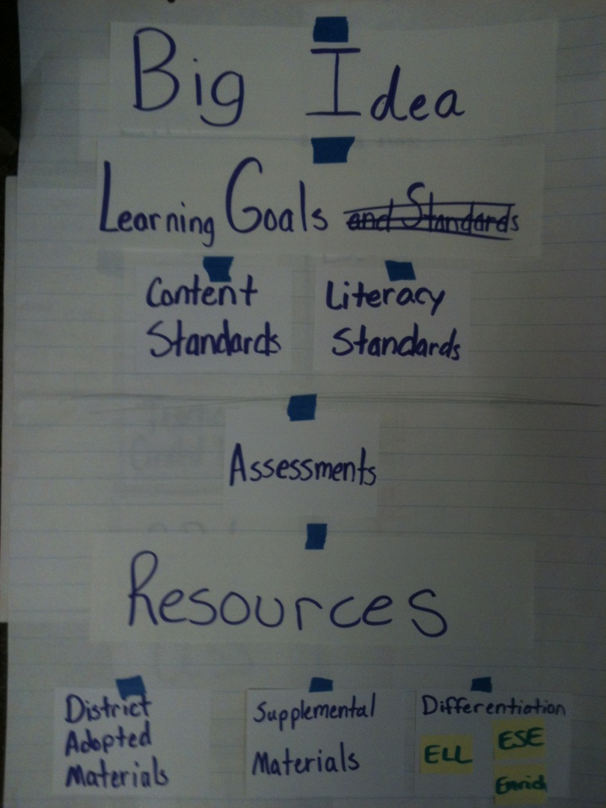
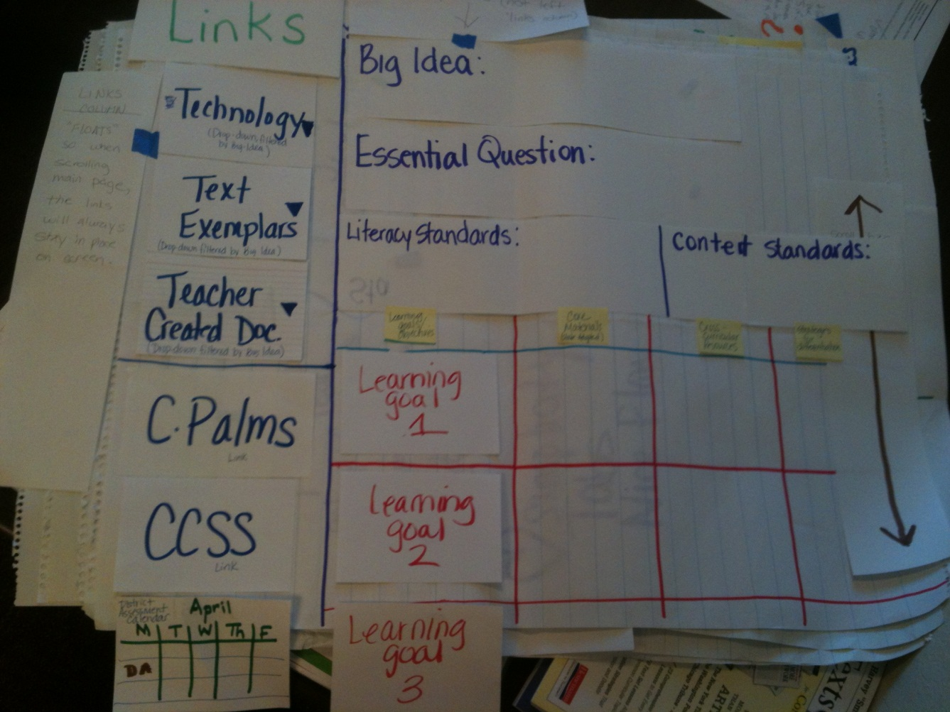
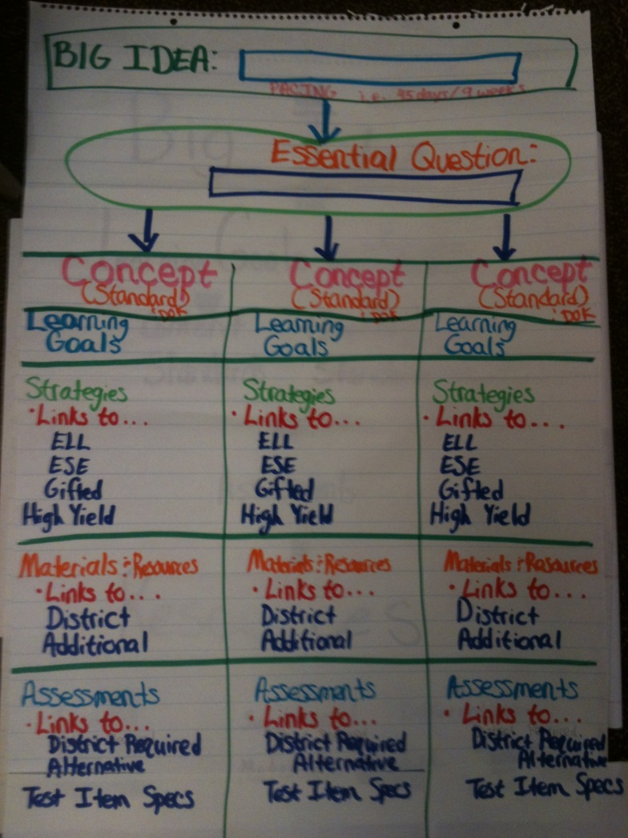
Teacher/Administrator Workgroups

Slide 11
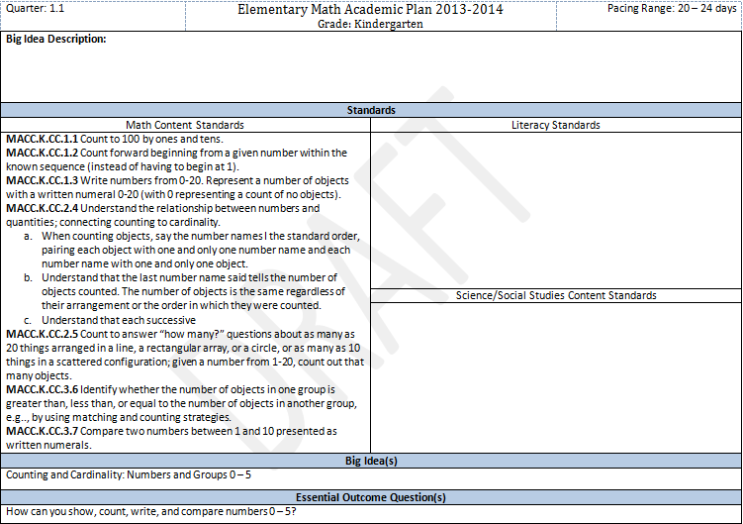
New Academic Plan Template

Slide 12
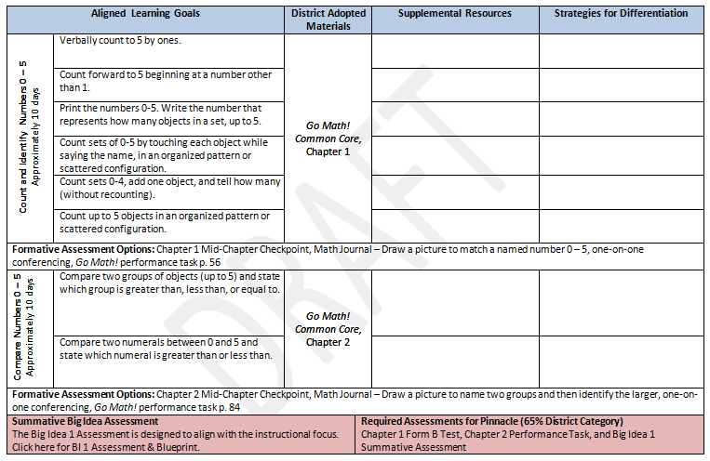

Slide 13
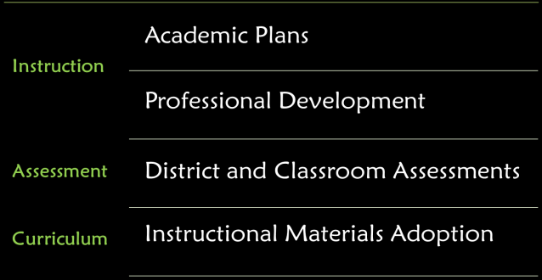

Professional Development: Affecting the Classroom
Adding the Pillars: 2012-2013 School Year
Text Complexity
Reading/SS Integration
Close Reading
Text-Dependent Questions
Math Talk
Coach & Contact Trainings

Slide 14



Professional Development: Affecting the Classroom
Building the Foundation
Dr. Tim Shanahan presents on the Challenge of the CCSS
Instructional Shifts of the CCSS ELA (Whole/Part)
FCAT 2.0 Reading & Math training
Summer 2012 CCSS Training (Text Complexity and CIS)
Fall/Spring: Close Reading
Summer/Fall: Text-Based Questioning
Notes:
At the district level, our best way to “touch” the classrooms is through professional development. By providing high-quality, “implementable” professional development we can affect the instruction that is occurring in the classrooms. The 11-12 school year was spent building a firm foundation for the implementation of CCSS classroom instruction. Several key professional development offerings were designed and provided in order to bring CCSS instruction into the classroom.

Slide 15

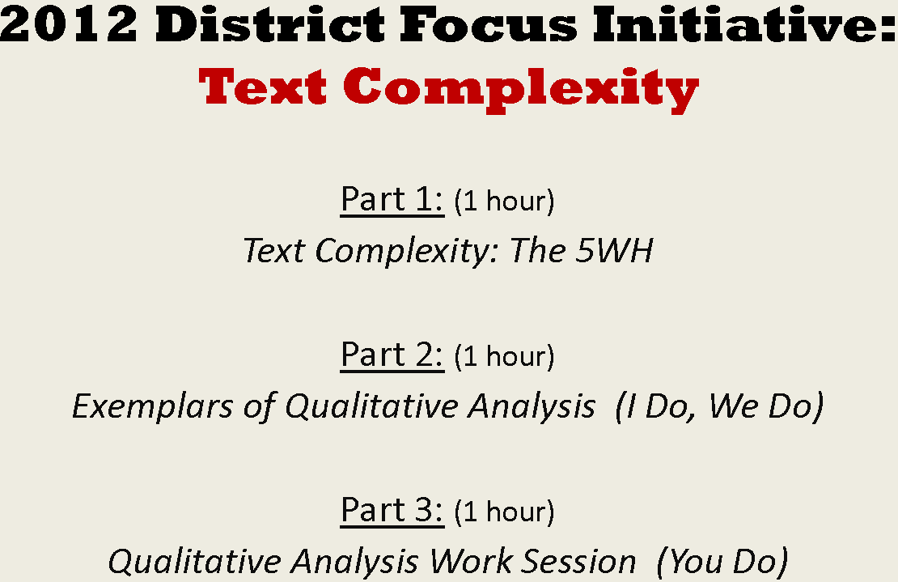
Adding the Pillars:
District Preschool Training – Text Complexity
Notes:
http://curriculum.leeschools.net/CCSS/timeline/pd/Summer%202012%20Elementary%20Common%20Core%20and%20DPS%20Trainings.pdf

Slide 16

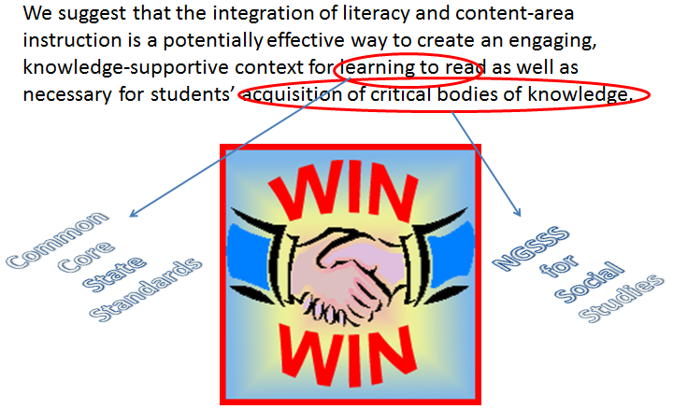
Adding the Pillars:
Reading/Social Studies Integration

Slide 17

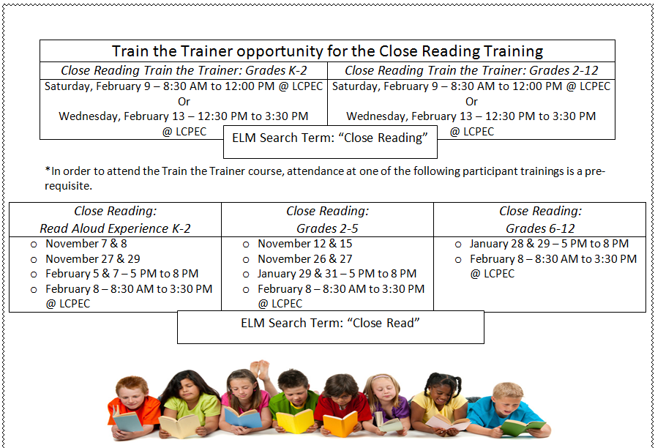
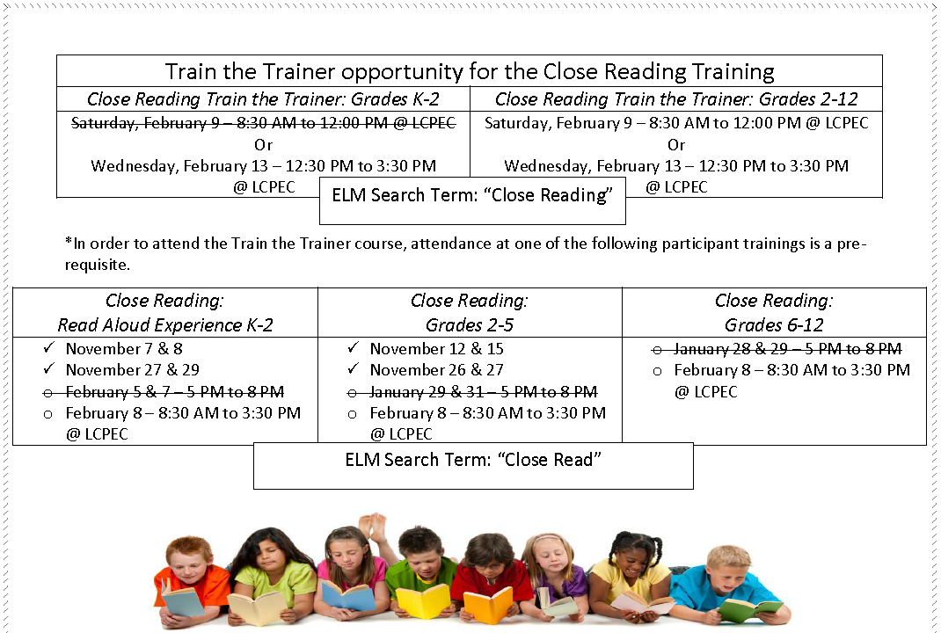
Adding the Pillars:
Close Reading

Slide 18

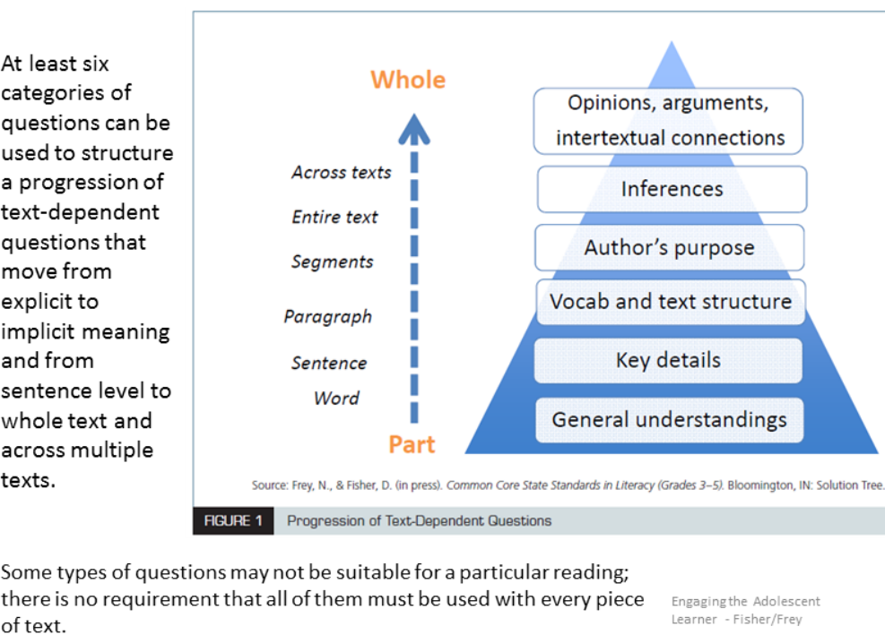
Adding the Pillars:
Text-Dependent Questions

Slide 19




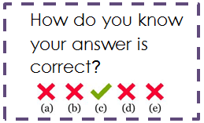



Adding the Pillars:
Math Talk

Slide 20

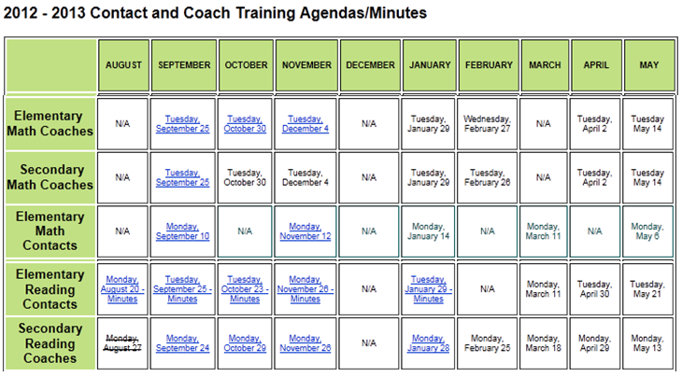
Adding the Pillars:
Coach & Contact Trainings

Slide 21

District and Classroom
Assessments
Data Driven Instruction
Formative
Summative

Slide 22
District Math Assessments
Blueprints
  Kindergarten and 1st grade Common Course Exams (CCEs) created to align with Common Core State Standard
  Serve as an instructional guide for administrators and teachers
  Contains information with regards to:
    Standards
    Depth of knowledge
    Quarter alignment
    Notes
  A link can be found in the academic plans

Slide 23
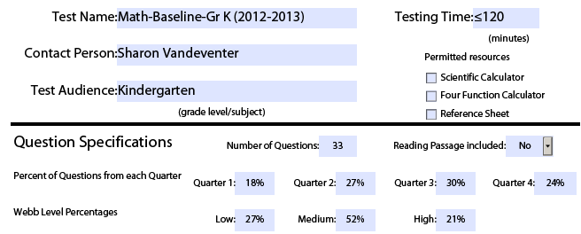
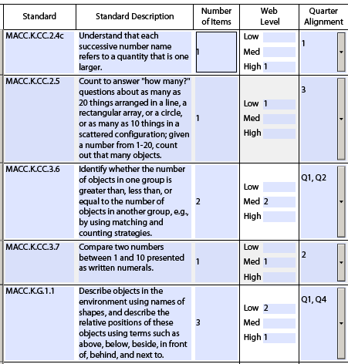
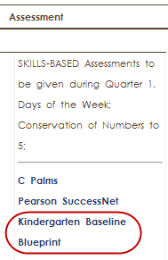
District Math Assessments
Notes:
Provide sample?

Slide 24

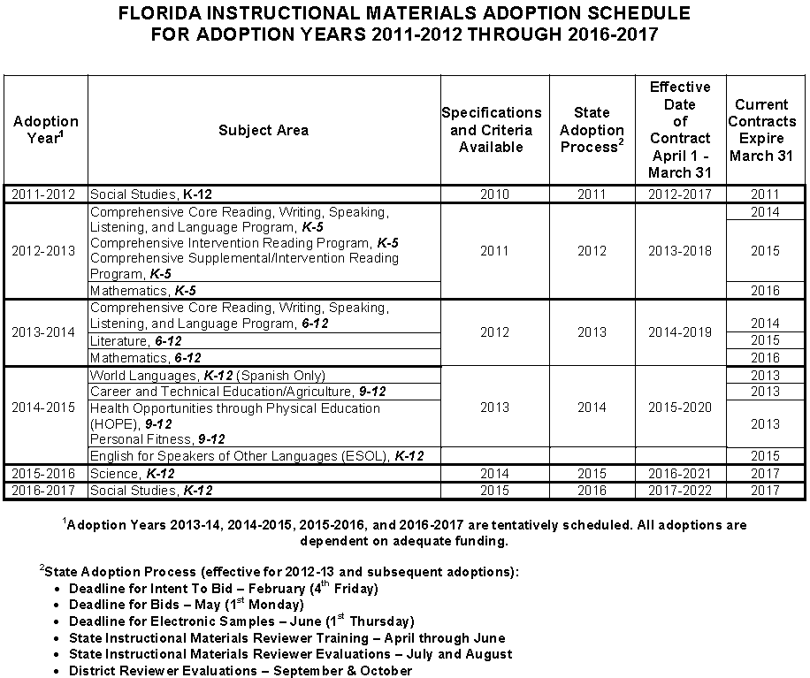
Instructional Materials Adoption
Adopting CCSS materials!!!
2012-2013 Adoption Process year for a 2013-2014 implementation!

Slide 25
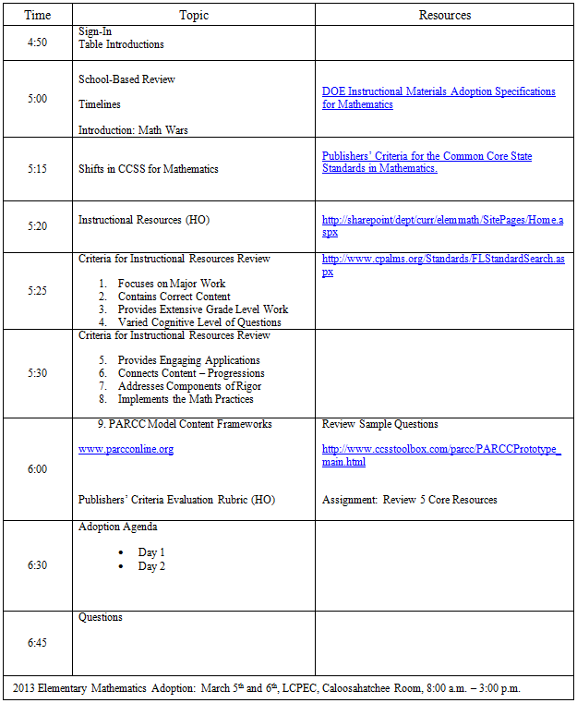


Slide 26
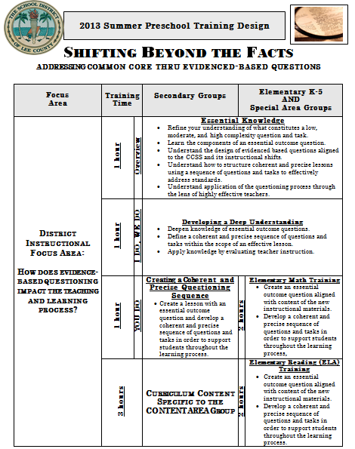
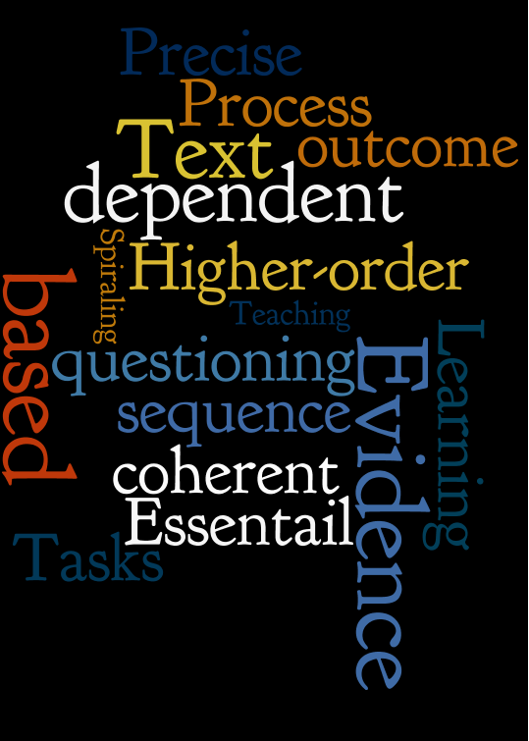
Professional Development
Summer 2013 Preschool Training
Notes:
Provide handout.

Slide 27
Questions

