Slide 1




Let’s take a walk through
the …
Spring Forum 2013
Kym Sheehan PARCC ELC Member
Charlotte County Public Schools
Parts of PPT
adapted from or modified from the
Miami-Dade
Institute of
Higher Learning
Presented by Vince Verges-Webinar

Slide 2
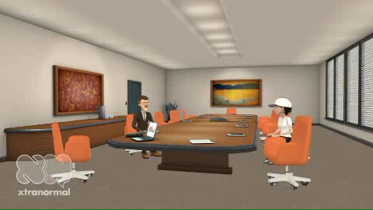
Before We Enter the PARCC…

Slide 3
Common Core & PARCC
Remember: Common Core Standards are the instructional part of learning
PARCC is an assessment (Formative & Summative)
Data from Assessment drives instruction for students & teachers

Slide 4
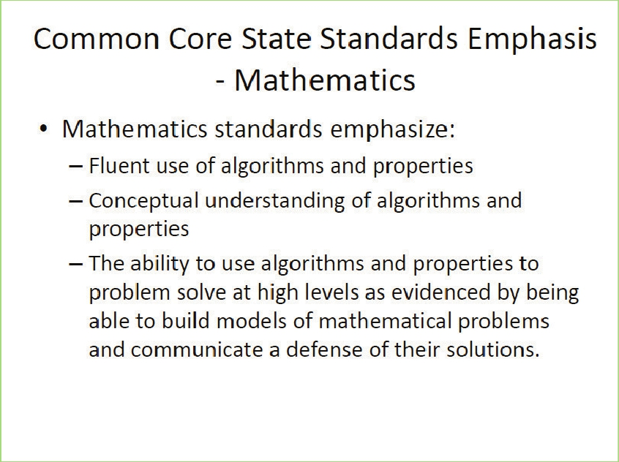

Slide 5
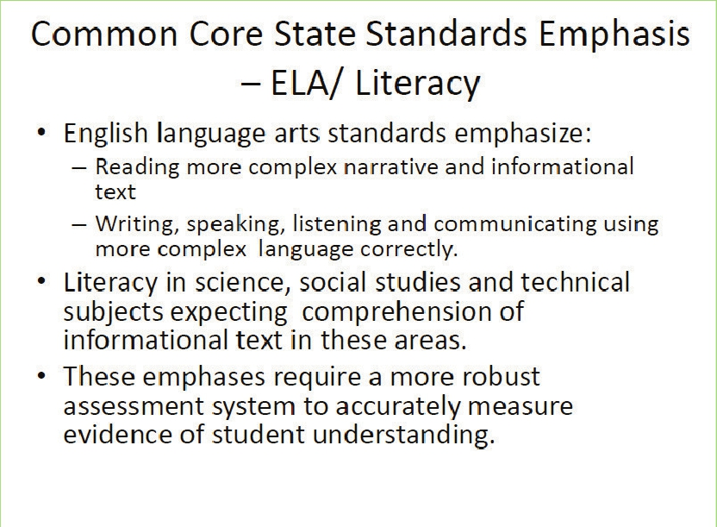

Slide 6
And Don’t Forget…
Literacy in:
History/Social Studies,
Science, and Technical Subjects

Slide 7
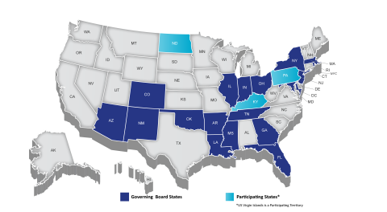
PARCC States
Collectively the states in PARCC educate about 24 million students. The PARCC states include: Arizona [2], Arkansas [3], Colorado [4], District of Columbia [5], Florida [6], Georgia [7], Illinois [8], Indiana [9], Kentucky [10], Louisiana [11], Maryland [12], Massachusetts [13], Mississippi [14], New Jersey [15], New Mexico [16], New York [17], North Dakota [18], Ohio [19], Oklahoma [20], Pennsylvania [21], Rhode Island [22], and Tennessee [23].

Slide 8
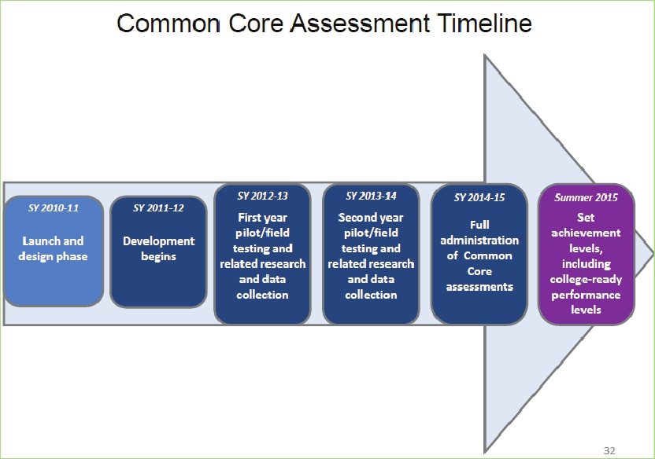

Slide 9
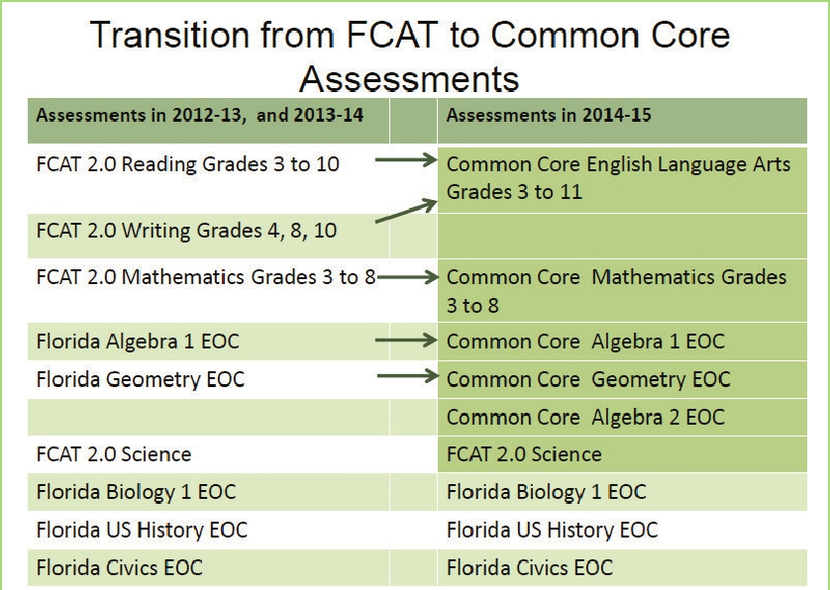

Slide 10
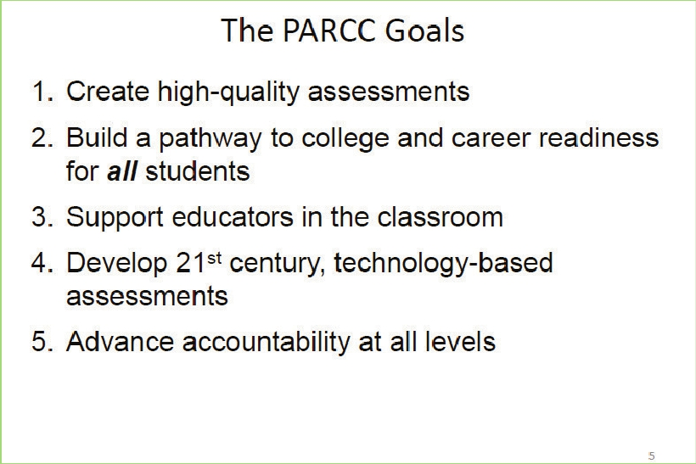

Slide 11
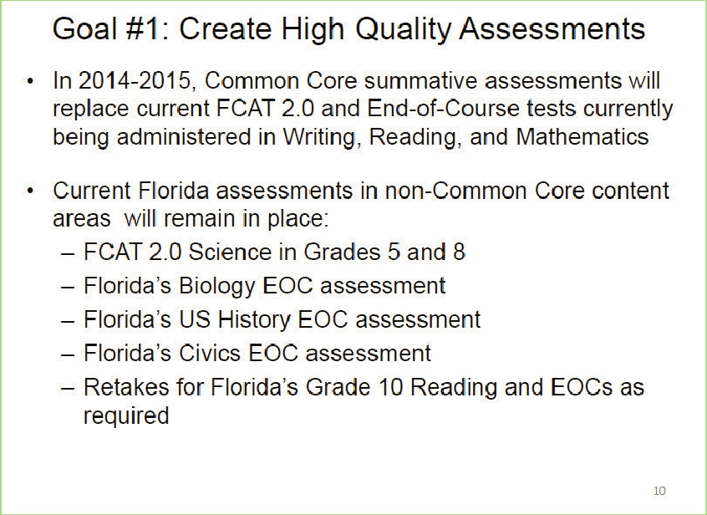

Slide 12
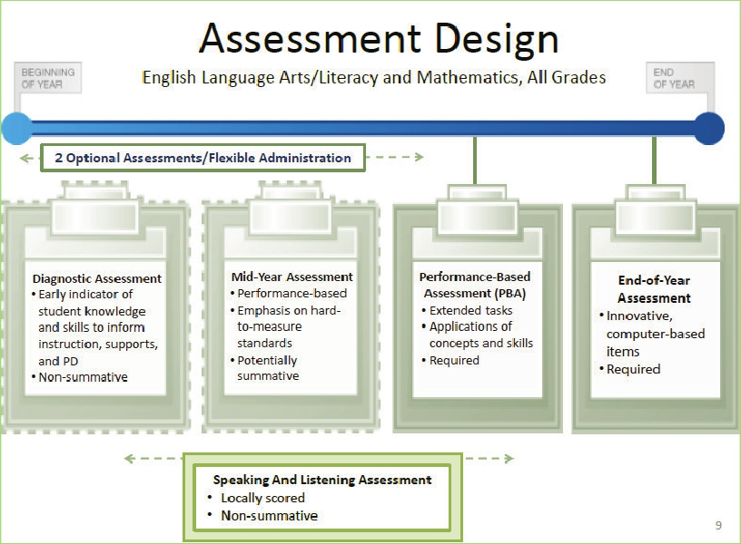

Slide 13
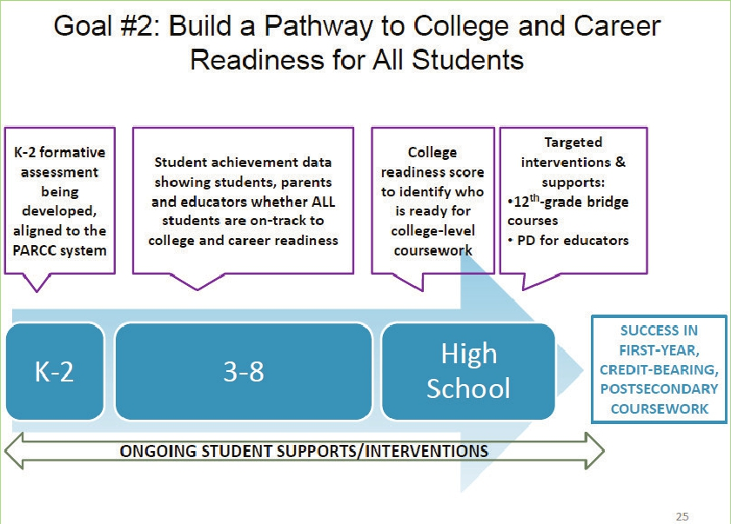

Slide 14
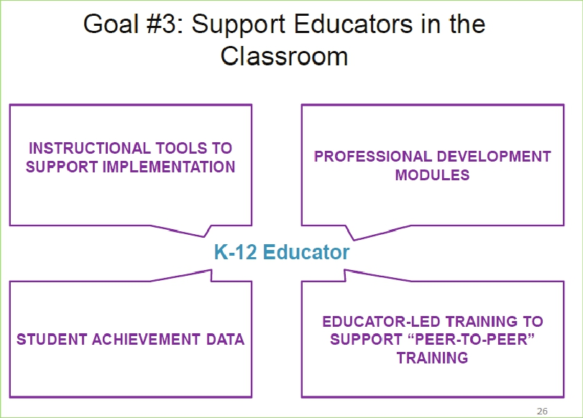

Slide 15
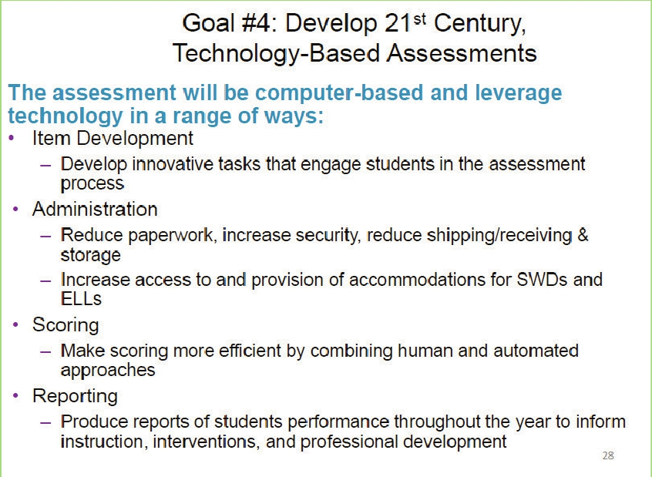

Slide 16
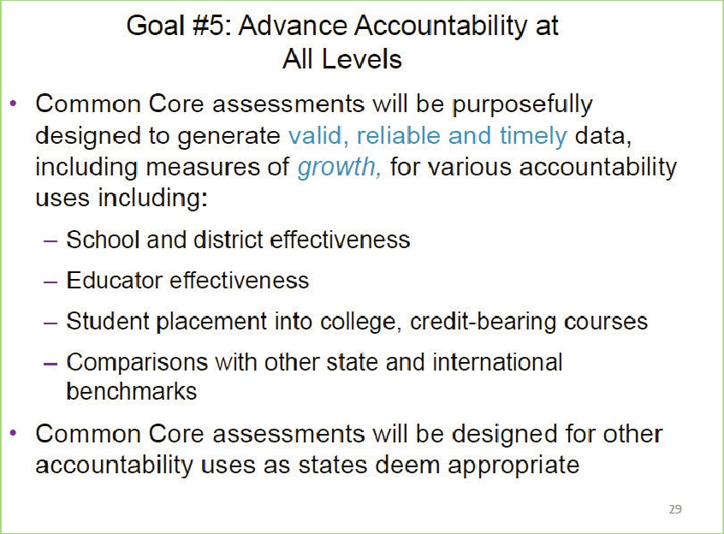

Slide 18
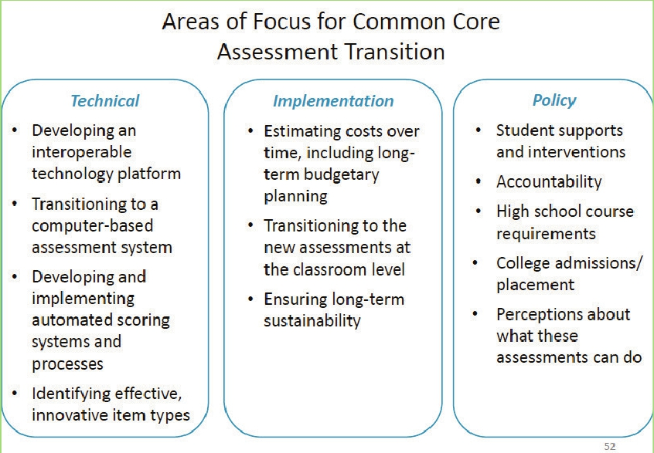
Is each district thinking about these areas of focus?

Slide 19
It All Begins With Data!
Classroom teachers ~previously untapped data – qualitative, school based, interest-based
Teacher teams/PLC & Lesson Study ~knowing your needs/Action Research
School leadership teams ~determining existing capacity and developing new if needed (policy, practice & more!)
District PD teams
State Professional Development Teams
Modeling, facilitating, practice implementation, etc.

Slide 20
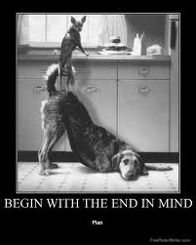
In Order to Support Educators...
Begin with the end in mind!
Google images.

Slide 21
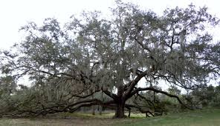

Let’s Rest in the PARCC to Read & Discuss for a While…

Slide 22
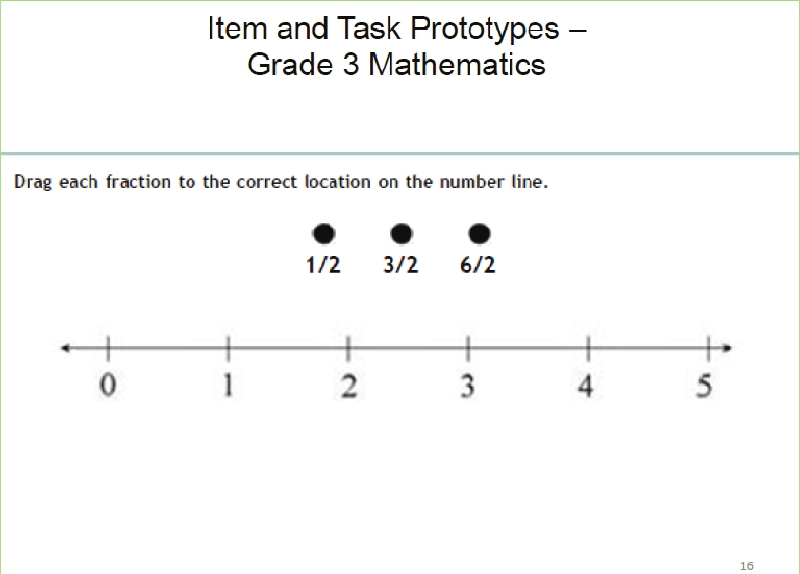

Slide 23
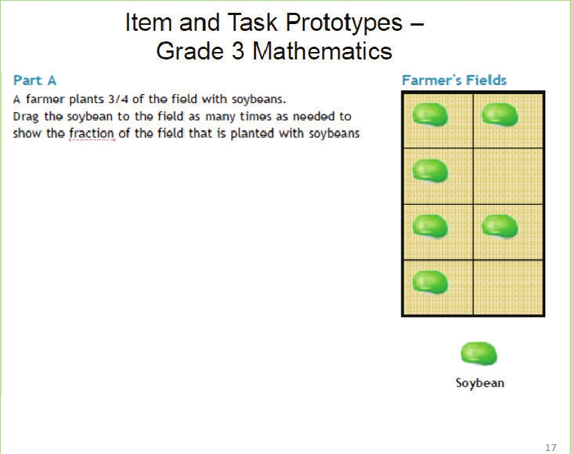

Slide 24
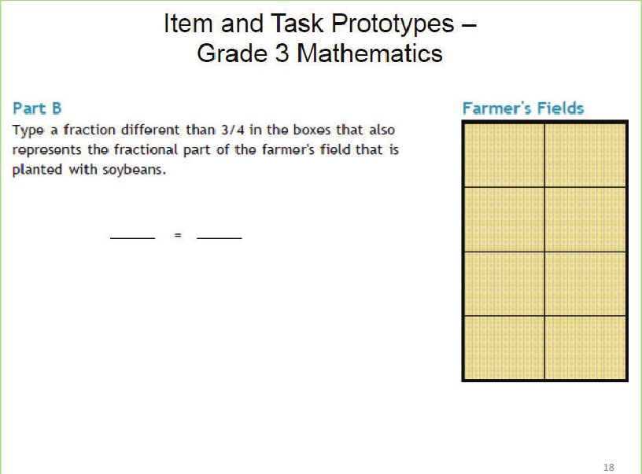

Slide 25
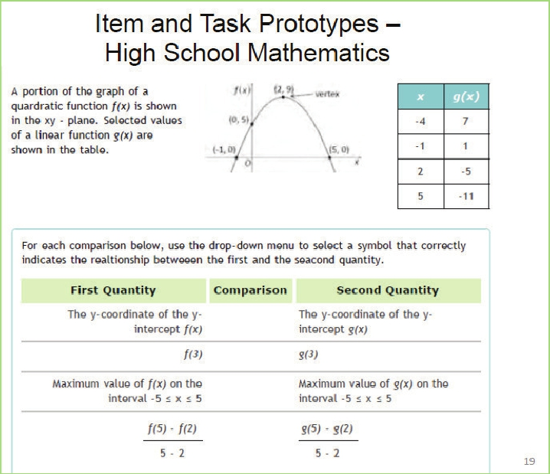

Slide 26
ELA Literacy Assessments
Gather information from single and multiple texts
Write to a source
Expectation is that students will be career/college ready
Mastery of reading skills assessed through writing.
Common Core ideology is to read like a detective and write like a reporter.
Close Reading
Cited sources
Technology Ready (Systemically & Our Students!)

Slide 27
ELA Literacy Assessments
Traditional multiple choice test items will still exist; however,
Innovative items will be included such as:
  Drag & drop
  Multiple-part/Multiple choice
  and writing.
Let’s look at some of the prototypes at various grade levels
Think about how you will use student data, help to support teacher, and implement Common Core & PARCC

Slide 28
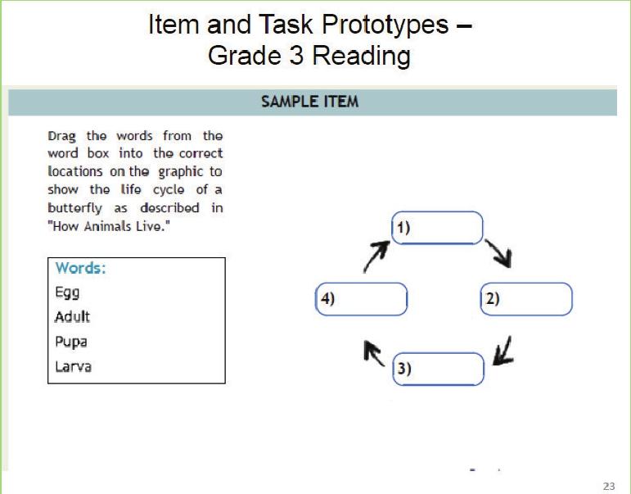

Slide 29
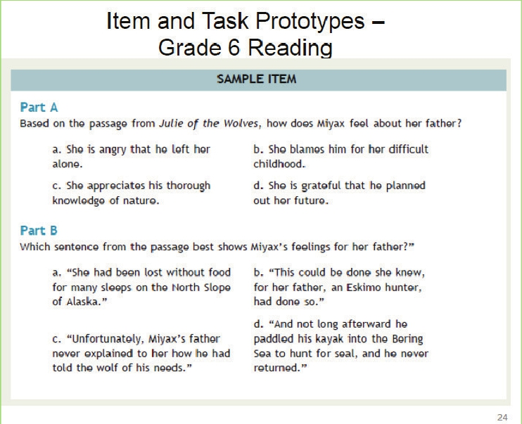

Slide 30


Media Sample ~ Grade 6

Slide 32
Student Directions: Grade 7
Based on the information in the text “Biography of Amelia Earhart,” write an essay that summarizes and explains the challenges Earhart faced throughout her life.
Remember to use textual evidence to support your ideas.
Answer:

Slide 33
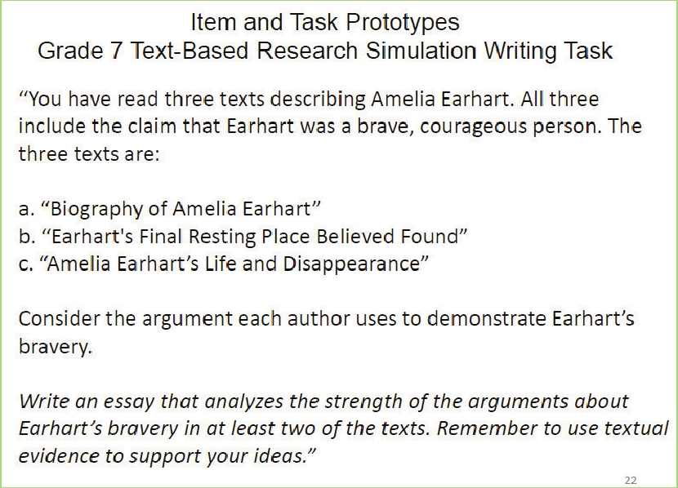

Slide 34
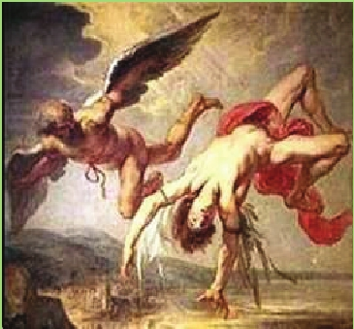

View Grade 10 ELA Prototype
•

Slide 35
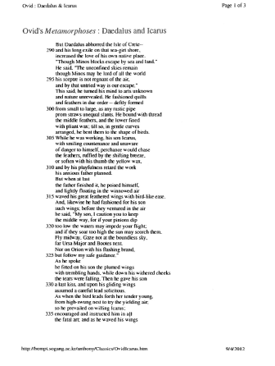

Slide 37

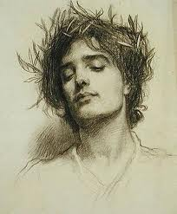
To an Athlete Dying Young~
A. E. Housman

Slide 38
To An Athlete Dying Young
By A. E. Housman (1859-1936)
The time you won your town the race
We chaired you through the market-place;
Man and boy stood cheering by,
And home we brought you shoulder-high.
Today, the road all runners come,
Shoulder-high we bring you home,
And set you at your threshold down,
Townsman of a stiller town.
What is the structure of the poem?
Does this lend to the understanding? Why or why not?
Compare and contrast the first two stanzas. Use textual evidence to discuss what is similar and what differs.
What vocabulary or phrases support your views?

Slide 39
To An Athlete…
Smart lad, to slip betimes away
From fields where glory does not stay,
And early though the laurel grows
It withers quicker than the rose.
Eyes the shady night has shut
Cannot see the record cut,
And silence sounds no worse than cheers
After earth has stopped the ears:
Analyze this section of the text for language and knowledge demands and levels of meaning.
Be prepared to cite textual evidence.
What questions would you ask to help students make meaning of this text?

Slide 40
To An Athlete…
Now you will not swell the rout
Of lads that wore their honours out,
Runners whom renown outran
And the name died before the man.
So set, before its echoes fade,
The fleet foot on the sill of shade,
And hold to the low lintel up
The still-defended challenge-cup.
And round that early-laurelled head
Wilt flock to gaze the strengthless dead,
And find unwithered on its curls
The garland briefer than a girl's.
Which words or phrases evoke images in the mind’s eye? Use textual evidence to support.
What is the significance of ‘laurel’ throughout the poem?
Writing prompt: Is glory ruinous or lucrative to one’s spirit? Take a stand.

Slide 41
Informational Paired Readings
Use for paired readings and/or additional readings. The Common Core Standards that we should see throughout lessons:
LACC.1112.RI.1.1 Cite strong and thorough textual evidence to support analysis of what the text says explicitly as well as inferences drawn from the text, including what the text leaves uncertain.
LACC.1112.RI.4.10 By the end of grades11/12 read and comprehend literary nonfiction at the high end of the grades 11-CCR text complexity band independently and proficiently. (LACC.1112.RL.4.10 is for literary reading)
LACC.1112.W.4.10 Write routinely over extended time frames and shorter time frames for a range of tasks, purposes, and audience.
From the works of Pausanias (2nd Century Greek traveler and geographer/writer.
Pan-Hellenic Games – 4 differing sporting events in a 4 year cycle/Laurel was not from the Olympic games…but from the games in Delphi
Victory Wreaths
The Olympics

Slide 42

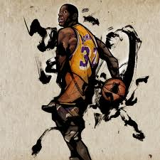
Paired Text
A Poem for Magic by Quincy Troupe

Slide 43
What Does This Mean for Professional Development?
List the positive aspects of these changes in learning
List the barriers that need to be addressed.

Slide 44
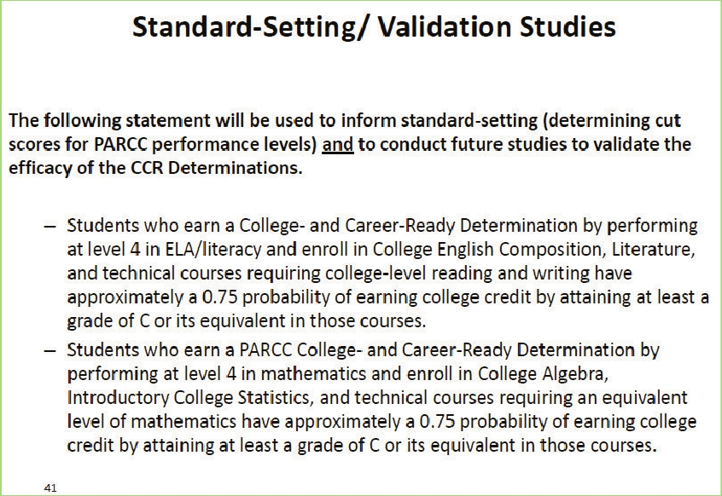

Slide 45
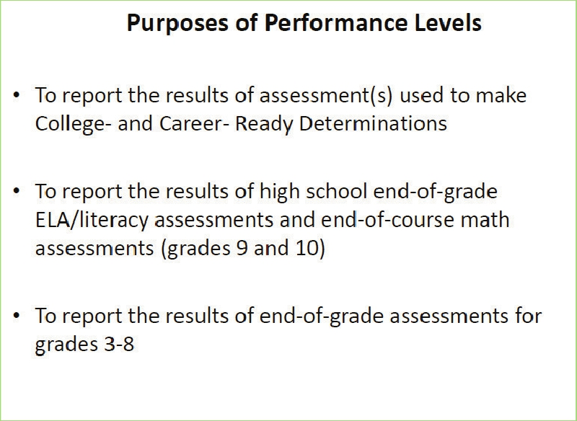

Slide 46
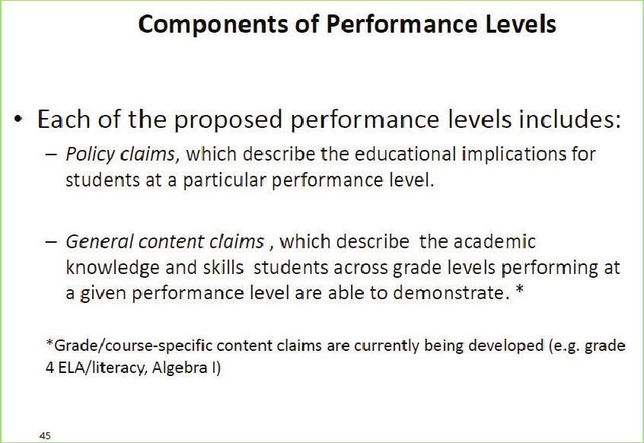

Slide 47
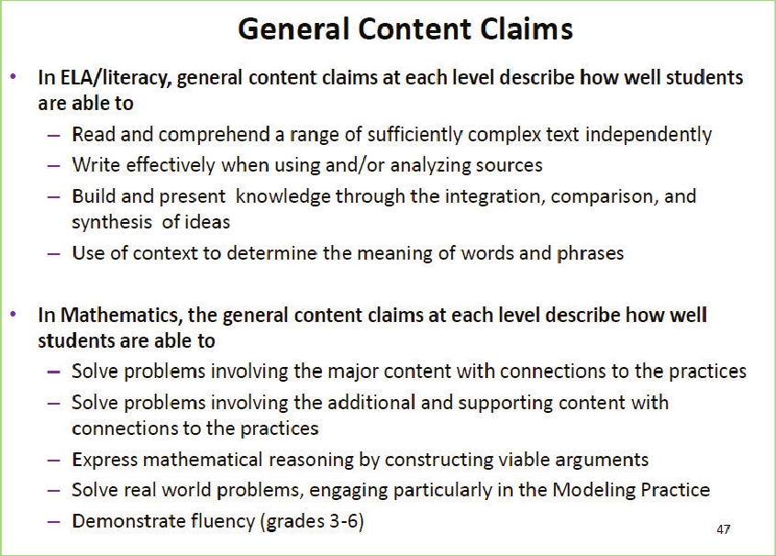

Slide 48
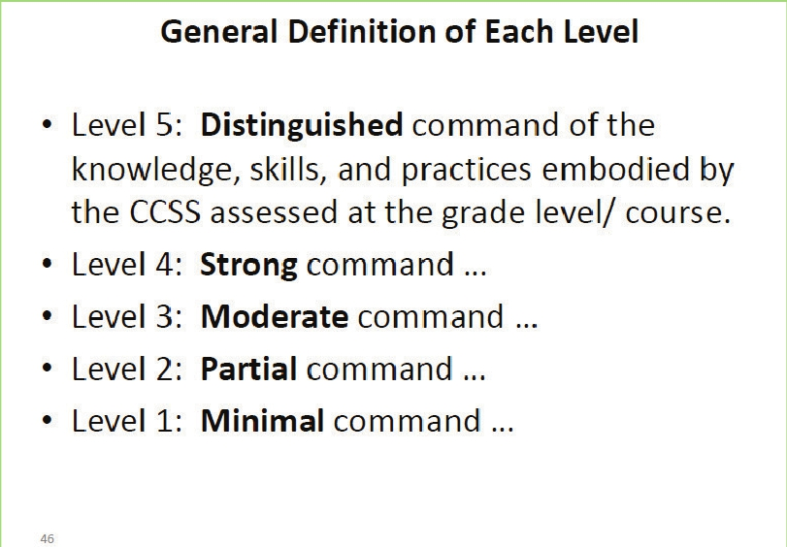

Slide 49
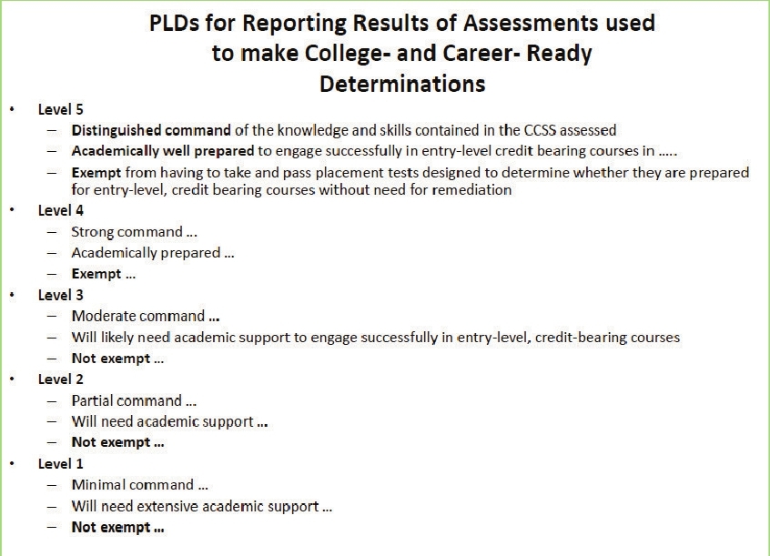
Performance Level Descriptors (PLD)

Slide 50
http://www.parcconline.org/ela-plds
http://www.parcconline.org/math-plds
Draft Released 4/2013

Slide 51
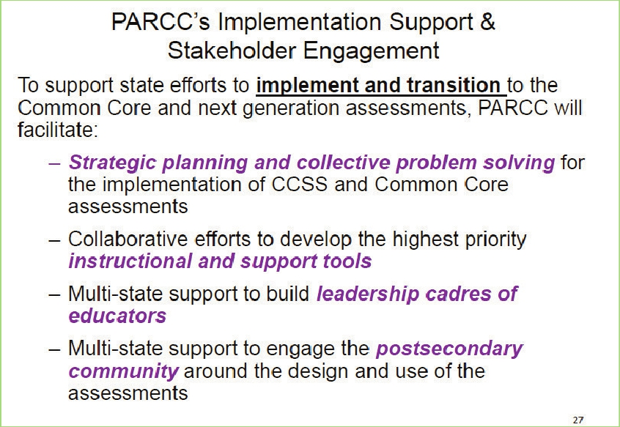

Slide 52
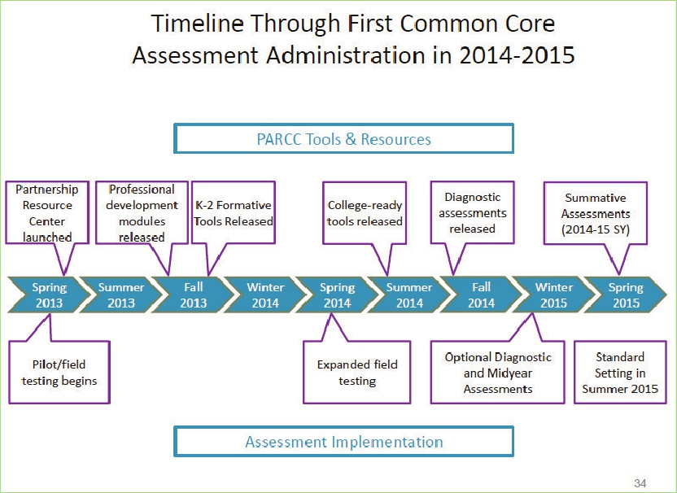

Slide 53
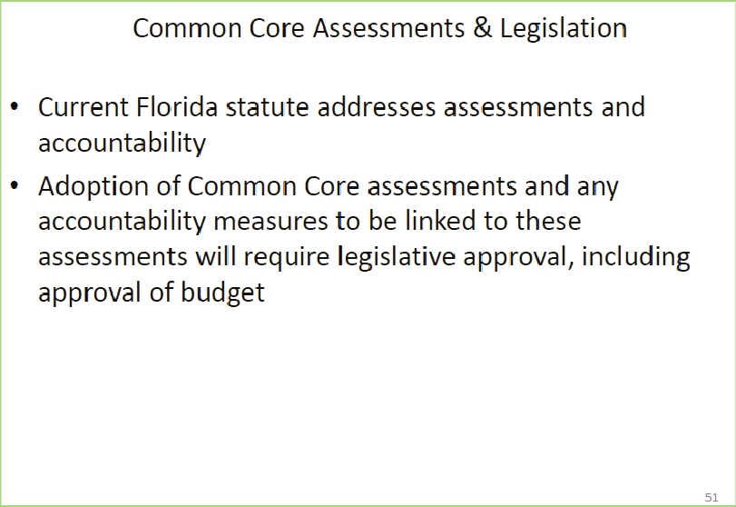

Slide 54


Kym_Sheehan@ccps.k12.fl.us
I am a member of Florida’s ELC or Educator Leader Cadre

